Slide 1



Noida Institute of Engineering and Technology, Greater Noida
Differential Calculus-II
Unit: 2
Subject Name
Mathematics-I
Faculty Name Harendra Singhal
Department
Mathematics
Course Details (B Tech Ist Sem.)

Slide 2
Content
Successive Differentiation(nth order derivatives)
Leibnitz’s theorem and its application
Asymptotes.
Curve tracing: Cartesian and Polar Co-ordinates
Partial derivatives
Total derivatives
Euler’s theorem for homogeneous functions

Slide 3
Course Objective
The objective of this course is to familiarize the graduate engineers with techniques in linear algebra. It aims to equip the students with standard concepts and tools from intermediate to advanced level of mathematics and applications that they would find useful in their disciplines

Slide 4
Course Outcome
Course Name: Mathematics-I
CO1-Apply the concept of matrices to solve linear simultaneous equations
CO2-Apply the concept of successive differentiation and partial differentiation to solve problems of Leibnitz theorems and total derivatives .
CO3-Apply partial differentiation for evaluating maxima, minima, Taylor’s series and Jacobians.

Slide 5
Course Outcome
CO4-Ilustrate multiple integral to find area, volume, centre of mass and centre of gravity.
CO5-Demonstrate the basic concept of Profit, Loss, Number & Series, Coding & decoding.

Slide 6
Program Outcomes (PO)
1.Engineering knowledge: Apply the knowledge of mathematics, science, engineering fundamentals, and an engineering specialization to the solution of complex engineering problems.
2.Problem analysis: Identify, formulate, review research literature, and analyze complex engineering problems reaching substantiated conclusions using first principles of mathematics, natural sciences, and engineering sciences.
3.Design/development of solutions: Design solutions for complex engineering problems and design system components or processes that meet the specified needs with appropriate consideration for the public health and safety, and the cultural, societal, and environmental considerations.
4.Conduct investigations of complex problems: Use research-based knowledge and research methods including design of experiments, analysis and interpretation of data, and synthesis of the information to provide valid conclusions.

Slide 7
Program Outcomes (PO)
5.Modern tool usage: Create, select, and apply appropriate techniques, resources, and modern engineering and IT tools including prediction and modeling to complex engineering activities with an understanding of the limitations.
6.The engineer and society: Apply reasoning informed by the contextual knowledge to assess societal, health, safety, legal and cultural issues and the consequent responsibilities relevant to the professional engineering practice.
7.Environment and sustainability: Understand the impact of the professional engineering solutions in societal and environmental contexts, and demonstrate the knowledge of, and need for sustainable development.
8.Ethics: Apply ethical principles and commit to professional ethics and responsibilities and norms of the engineering practice.

Slide 8
Program Outcomes (PO)
9. Individual and team work : Function effectively as an individual, and as a member or leader in diverse teams, and in multidisciplinary settings.
10.Communication: Communicate effectively on complex engineering activities with the engineering community and with society at large, such as, being able to comprehend and write effective reports and design documentation, make effective presentations, and give and receive clear instructions.
11.Project management and finance: Demonstrate knowledge and understanding of the engineering and management principles and apply these to one’s own work, as a member and leader in a team , to manage projects and in multidisciplinary environments.
12. Life-long learning: Recognize the need for, and have the preparation and ability to engage in independent and life-long learning in the broadest context of technological change.

Slide 9
CO-PO and PSO Mapping
CO-PO Matrices 2020-21
B.Tech. Ist Year -First semester
Course Name: Mathematics-I
CO | PO-1 | PO-2 | PO-3 | PO-4 | PO-5 | PO-6 | PO-7 | PO-8 | PO-9 | PO-10 | PO-11 | PO-12
CO1 | 3 | 2 | 1 | 1 | 3 | 2 | - | - | - | 2 | 2 | 3
CO2 | 3 | 3 | 2 | 3 | 3 | - | - | - | - | 2 | 3 | 3
CO3 | 3 | 2 | 3 | 3 | 3 | 2 | - | - | - | 2 | 3 | 3
CO4 | 3 | 2 | 3 | 3 | 2 | 2 | - | - | - | 2 | 2 | 3
CO5 | 1 | 1 | 1 | 1 | 1 | - | - | - | - | 2 | - | 3
Mean | 2.6 | 2 | 2 | 2.2 | 2.4 | 2.0 | - | - | - | 2 | 2.5 | 3

Slide 10
Objective of the topic,(CO2..)
Successive differentiation and Leibniz’s theorem
In this section we will learn the following topic:
Definition of successive derivatives.
The notion of successive differentiation.
The Leibniz’s formula.
The related problems

Slide 11
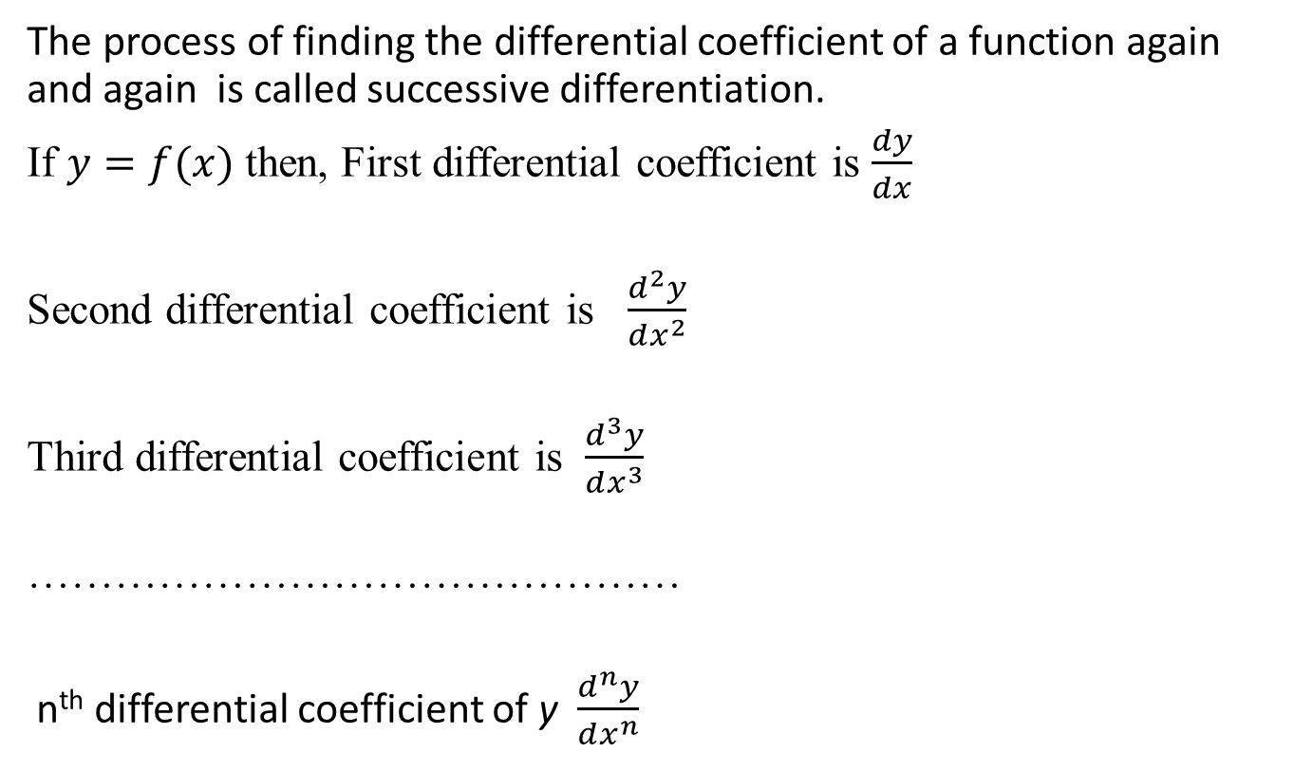
Successive Differentiation,(CO2..)
The process of finding the differential coefficient of a function again and again is called successive differentiation.
If $y=f(x)$ then, First differential coefficient is $\frac{dy}{dx}$
Second differential coefficient is $\frac{d^{2}y}{dx^{2}}$
Third differential coefficient is $\frac{d^{3}y}{dx^{3}}$
………………………………………
n^{th}differential coefficient of y $\frac{d^{n}y}{dx^{n}}$

Slide 12
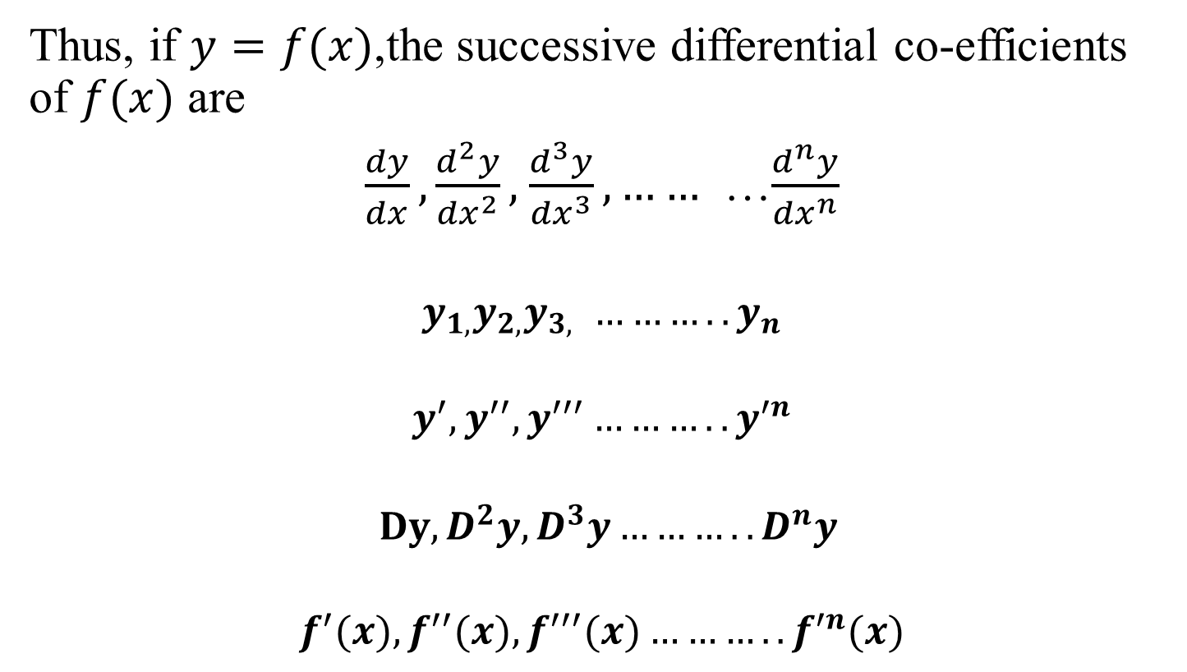
Successive Differentiation,(CO2..)
Thus, if $y=f(x)$,the successive differential co-efficients of $f(x)$ are
$\frac{dy}{dx},\frac{d^{2}y}{{dx}^{2}},\frac{d^{3}y}{{dx}^{3}},……$ …$\frac{d^{n}y}{{dx}^{n}}$
$$y_{1,}y_{2,}y_{3, }………..y_{n}$$
$$y^{′},y^{′′},y^{′′′}………..y^{′n}$$
$$Dy,D^{2}y,D^{3}y………..D^{n}y$$
$$f^{′}(x),f^{′′}(x),f^{′′′}(x)………..f^{′n}(x)$$

Slide 13
Successive Differentiation,(CO2..)
n^{th} derivative of some elementary functions-

Slide 14
Successive Differentiation,(CO2..)

Slide 15
Successive Differentiation,(CO2..)

Slide 16
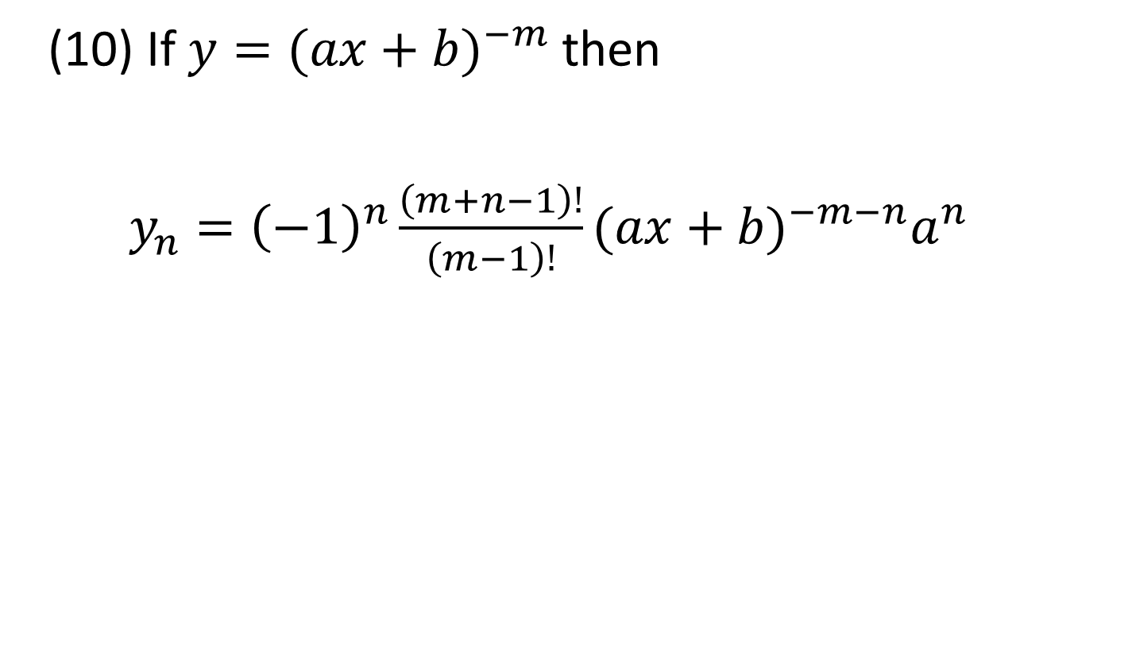
Successive Differentiation,(CO2..)
(10) If $y={(ax+b)}^{−m}$ then
$$y_{n}={\left(−1\right)}^{n}\frac{\left(m+n−1\right)!}{\left(m−1\right)!}{(ax+b)}^{−m−n}a^{n}$$

Slide 17
Successive Differentiation,(CO2..)

Slide 18
Successive Differentiation,(CO2..)

Slide 19
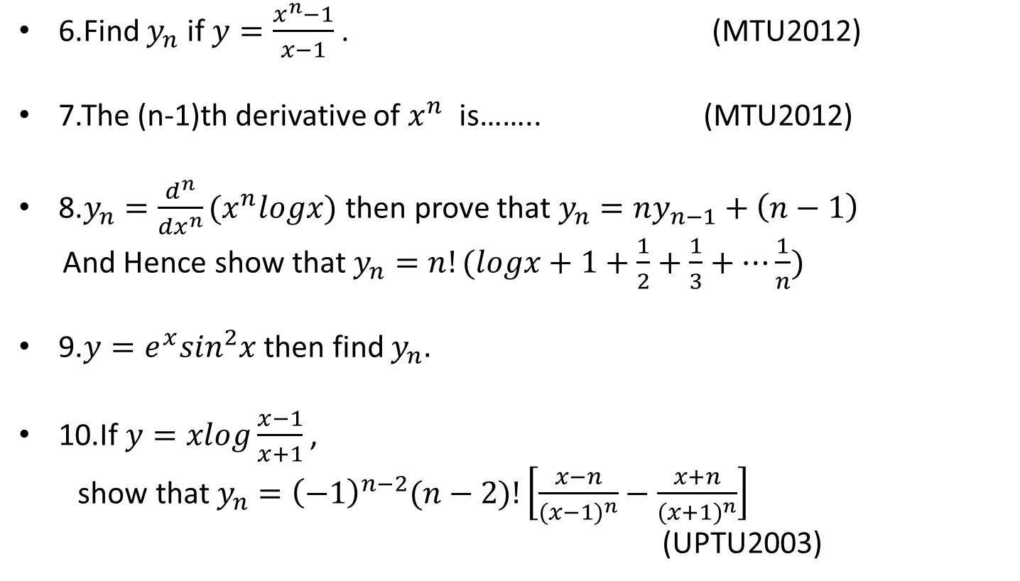
Successive Differentiation,(CO2..)
6.Find $y_{n}$ if $y=\frac{x^{n}−1}{x−1}$. (MTU2012)
7.The (n-1)th derivative of $x^{n}$ is…….. (MTU2012)
8.$y_{n}=\frac{d^{n}}{{dx}^{n}}(x^{n}logx)$ then prove that $y_{n}=ny_{n−1}+\left(n−1\right)$
And Hence show that $y_{n}=n!(logx+1+\frac{1}{2}+\frac{1}{3}+…\frac{1}{n})$
9.$y=e^{x}\sin^{2}x$ then find $y_{n}.$
10.If $y=xlog\frac{x−1}{x+1}$ ,
show that $y_{n}={\left(−1\right)}^{n−2}(n−2)!\left[\frac{x−n}{{(x−1)}^{n}}−\frac{x+n}{{(x+1)}^{n}}\right]$
(UPTU2003)

Slide 20
Leibnitz theorem,(CO2..)
This helps us to find the n^{th} differential co-efficient of the product of two functions in terms of the successive derivatives of the functions.
Statement:
If u and v are two functions of x, having derivatives of the n^{th} order, then
where suffixes of u and v denote the differentiation w.r.t. x.

Slide 21
Leibnitz theorem,(CO2..)

Slide 22
Leibnitz theorem,(CO2..)

Slide 23
Leibnitz theorem,(CO2..)

Slide 24
Leibnitz theorem,(CO2..)

Slide 25
Leibnitz theorem,(CO2..)

Slide 26
Leibnitz theorem,(CO2..)

Slide 27

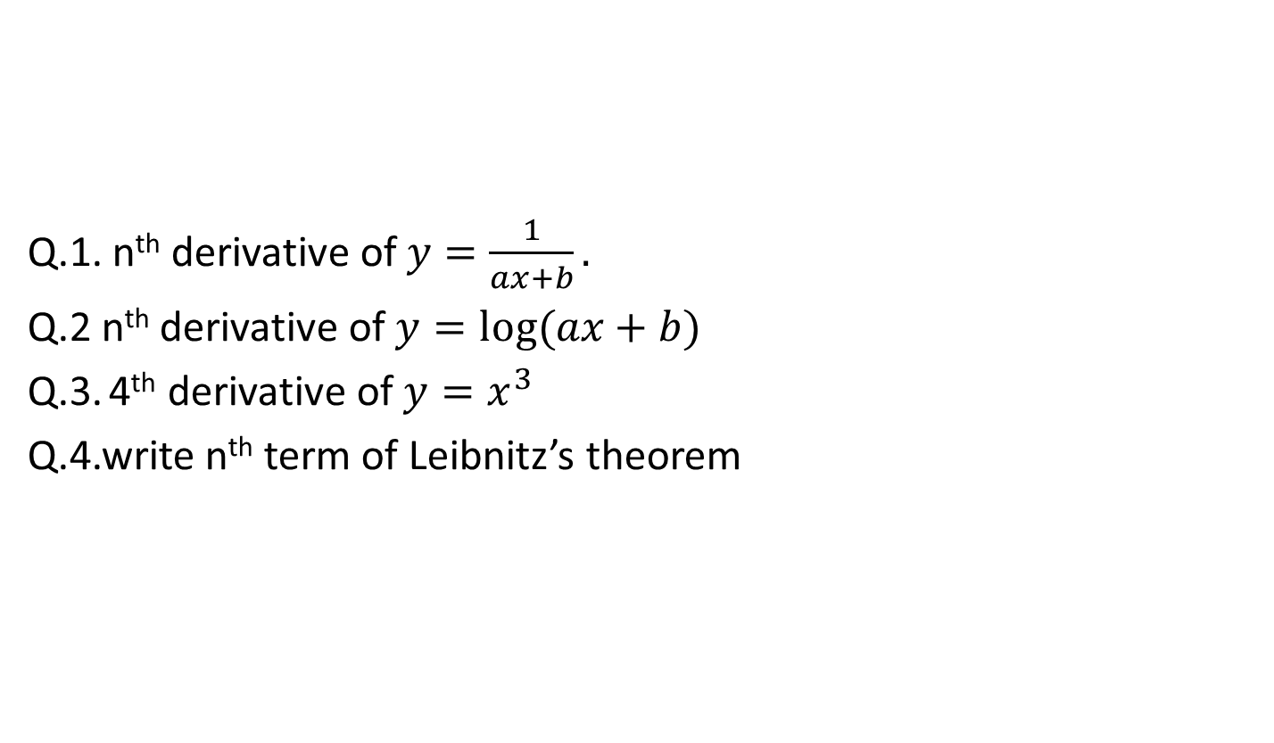
Leibnitz theorem,(CO2..)
Q.1. n^{th}derivative of$y=\frac{1}{ax+b}.$
Q.2 n^{th} derivative of$y=log⁡(ax+b)$
Q.3.4thderivative of$y=x^{3}$
Q.4.write n^{th}term of Leibnitz’s theorem

Slide 28
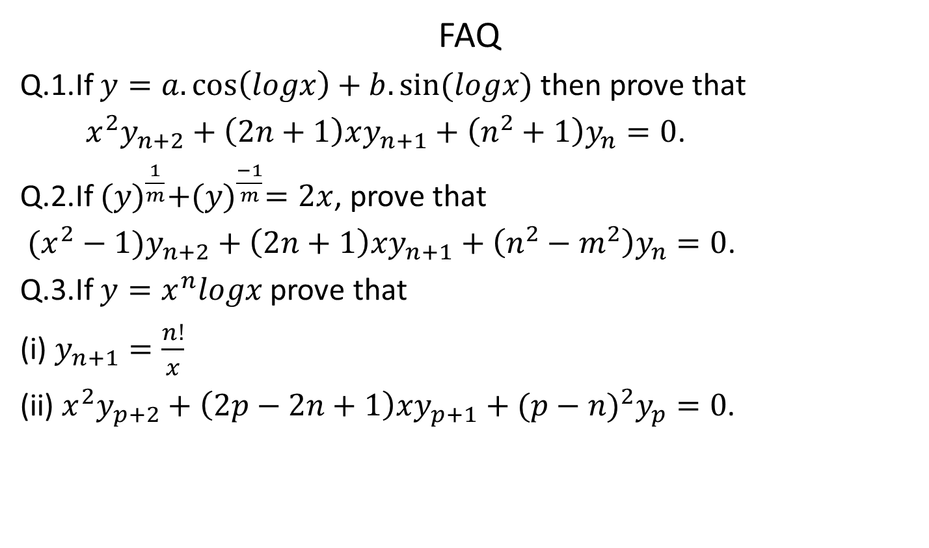
Leibnitz theorem,(CO2..)
FAQ
Q.1.If $y=a.\cos\left(logx\right)+b.sin⁡(logx)$ then prove that
$x^{2}y_{n+2}+\left(2n+1\right)xy_{n+1}+\left(n^{2}+1\right)y_{n}=0$.
Q.2.If ${(y)}^{\frac{1}{m}}+{(y)}^{\frac{−1}{m}}=2x$, prove that
$(x^{2}−1)y_{n+2}+\left(2n+1\right)xy_{n+1}+\left(n^{2}−m^{2}\right)y_{n}=0$.
Q.3.If ${y=x}^{n}logx$ prove that
(i) $y_{n+1}=\frac{n!}{x}$
(ii) $x^{2}y_{p+2}+\left(2p−2n+1\right)xy_{p+1}+{(p−n)}^{2}y_{p}=0$.

Slide 29
Recap
In this chapter, we discussed the following points
Successive Differentiation i.e.
The process of finding the differential coefficient of a function again and again is called successive differentiation.
2. Leibnitz theorem i.e.

Slide 30
Objective of the topic,(CO2..)
Asymptotes and Curve Tracing
An asymptote of a curve is a line such that the distance between the curve ... information about the behavior of curves in the large, and determining the asymptotes of a function is an important step in sketching its graph.

Slide 31
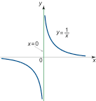
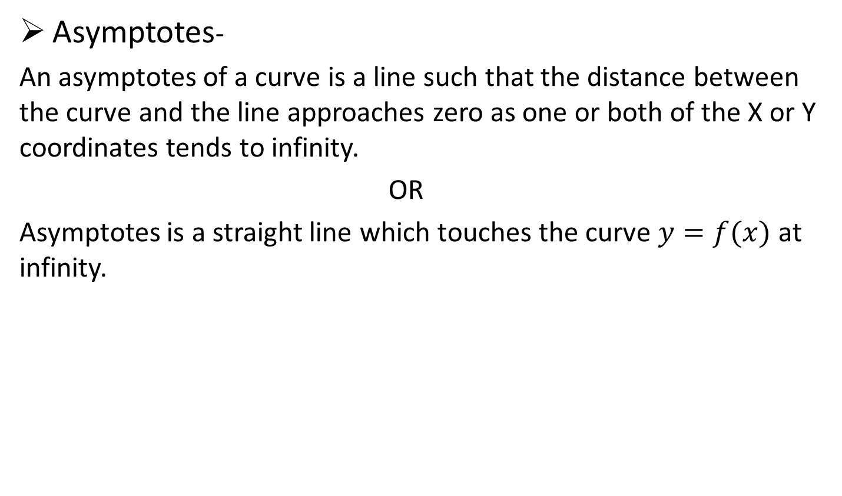
Asymptotes,(CO2..)
Asymptotes-
An asymptotes of a curve is a line such that the distance between the curve and the line approaches zero as one or both of the X or Y coordinates tends to infinity.
OR
Asymptotes is a straight line which touches the curve $y=f(x)$ at infinity.

Slide 32
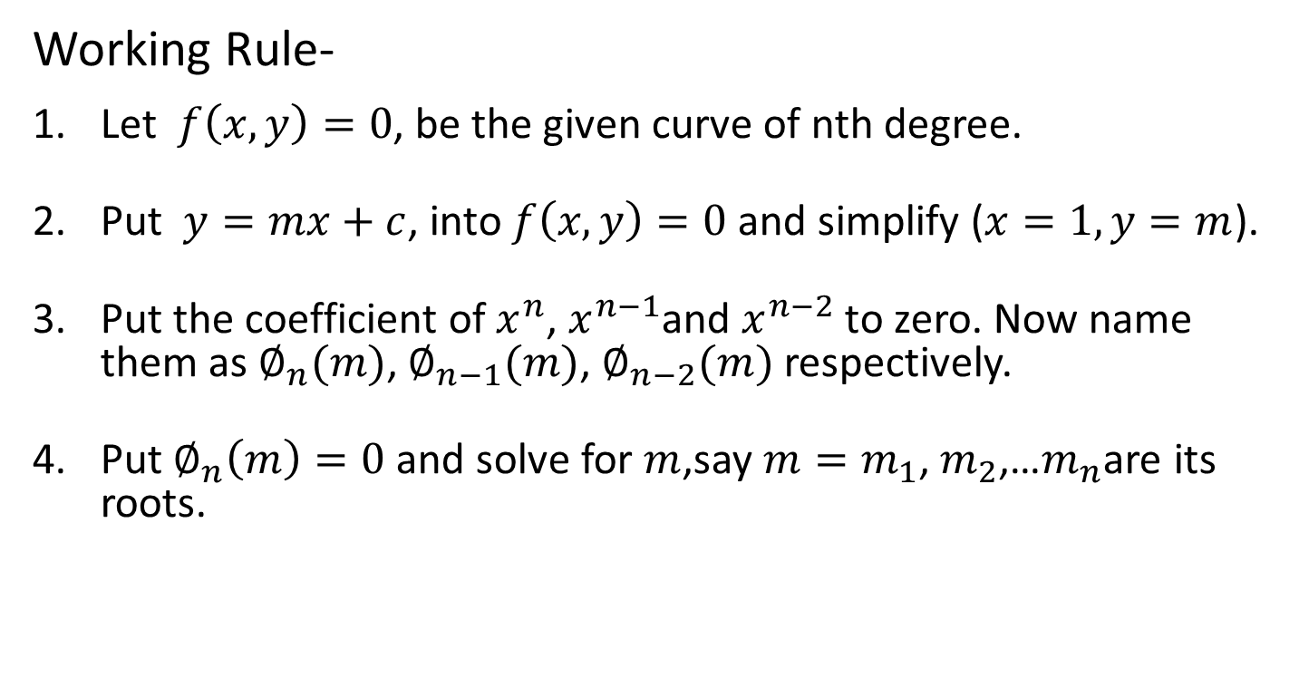
Asymptotes,(CO2..)
Working Rule-
Let $f\left(x,y\right)=0$, be the given curve of nth degree.
Put $y=mx+c$, into$f\left(x,y\right)=0$ and simplify ($x=1, y=m$).
Put the coefficient of$x^{n}$,$x^{n−1}$and $x^{n−2}$ to zero. Now name them as $∅_{n}(m)$,$∅_{n−1}(m)$,$∅_{n−2}(m)$ respectively.
Put$∅_{n}\left(m\right)=0$ and solve for $m$,say $m=m_{1}$,$m_{2}$,…$m_{n}$are its roots.

Slide 33
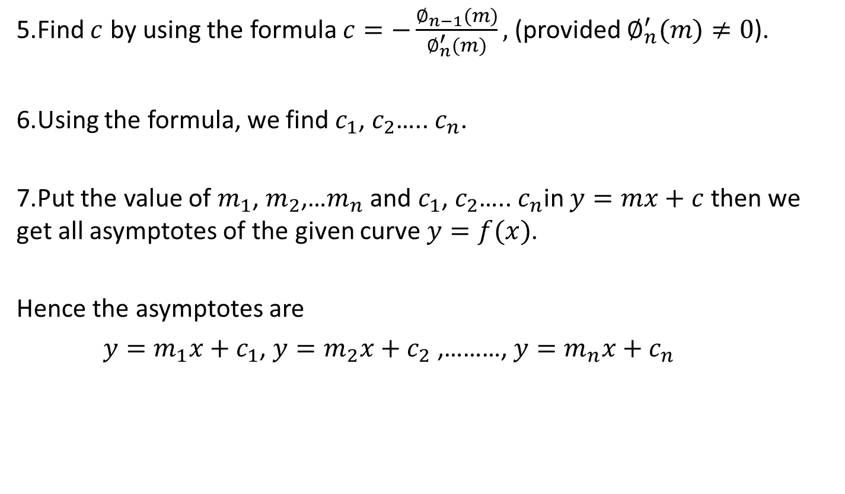
Asymptotes,(CO2..)
5.Find $c$ by using the formula$c=−\frac{∅_{n−1}(m)}{∅_{n}^{′}(m)},$ (provided $∅_{n}^{′}(m)≠0$).
6.Using the formula, we find $c_{1}$,$c_{2}$…..$c_{n}$.
7.Put the value of $m_{1}$, $m_{2}$,…$m_{n}$ and $c_{1}$, $c_{2}$….. $c_{n}$in$y=mx+c$ then we get all asymptotes of the given curve$y=f(x)$.
Hence the asymptotes are
$y=m_{1}x+c_{1}$,$y=m_{2}x+c_{2}$ ,………, $y=m_{n}x+c_{n}$

Slide 34
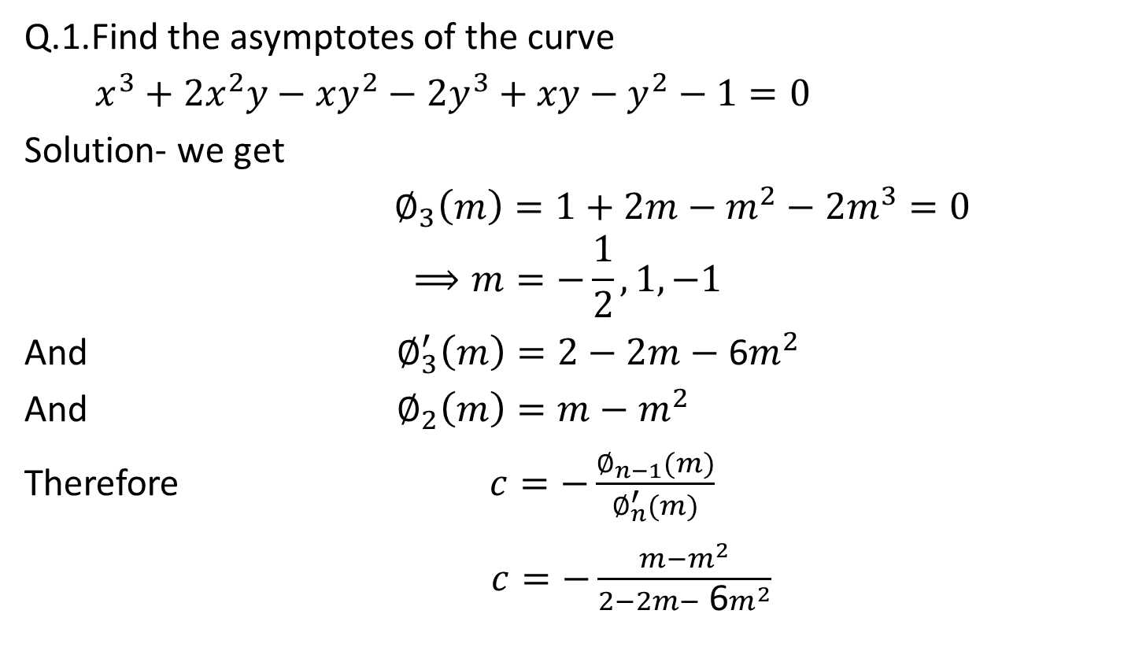
Asymptotes,(CO2..)
Q.1.Find the asymptotes of the curve
$$x^{3}+2x^{2}y−xy^{2}−2y^{3}+xy−y^{2}−1=0$$
Solution- we get
$$∅_{3}\left(m\right)=1+2m−m^{2}−{2m}^{3}=0$$
$$⟹m=−\frac{1}{2},1,−1$$
And $∅_{3}^{′}\left(m\right)=2−2m−$ 6$m^{2}$
And $∅_{2}\left(m\right)=m−m^{2}$
Therefore $c=−\frac{∅_{n−1}(m)}{∅_{n}^{′}(m)}$
$$c=−\frac{m−m^{2}}{2−2m− \text{6}m^{2}}$$

Slide 35
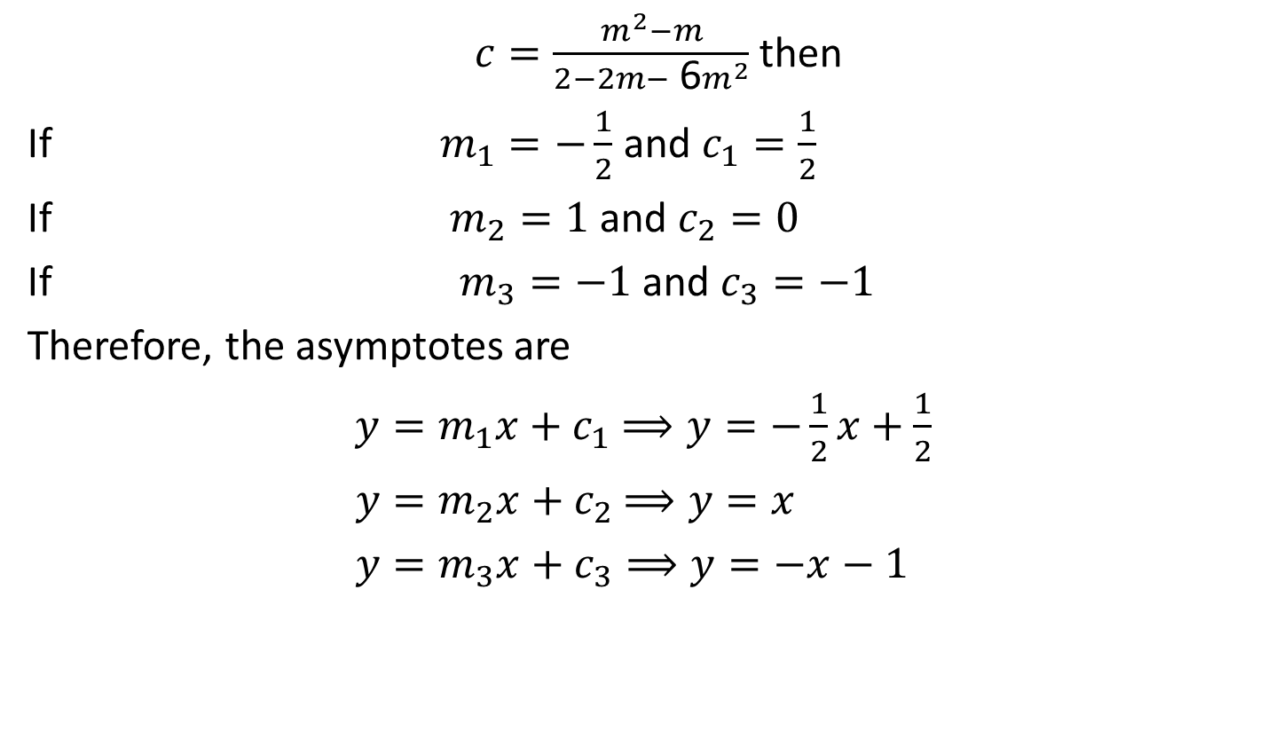
Asymptotes,(CO2..)
$c=\frac{m^{2}−m}{2−2m− \text{6}m^{2}}$ then
If $m_{1}=−\frac{1}{2}$ and $c_{1}=\frac{1}{2}$
If $m_{2}=1$ and $c_{2}=0$
If $m_{3}=−1$ and $c_{3}=−1$
Therefore, the asymptotes are
$$y=m_{1}x+c_{1}⟹y=−\frac{1}{2}x+\frac{1}{2}$$
$$y=m_{2}x+c_{2}⟹y=x$$
$$y=m_{3}x+c_{3}⟹y=−x−1$$

Slide 36
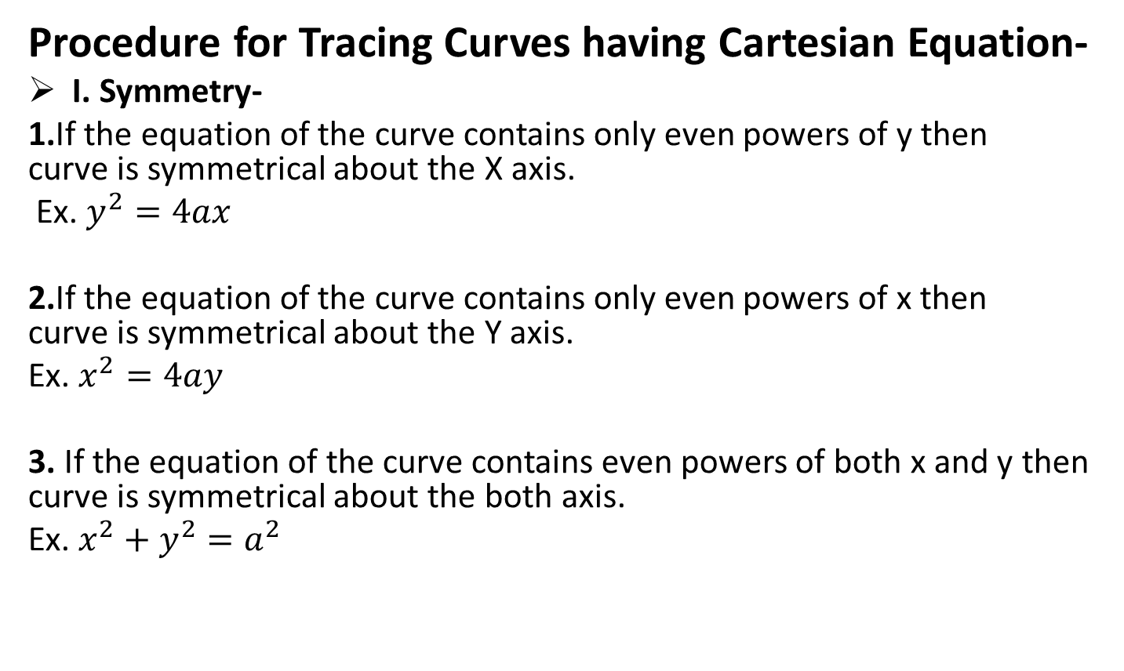
Curve Tracing, (CO2..)
Procedure for Tracing Curves having Cartesian Equation-
I. Symmetry-
1.If the equation of the curve contains only even powers of y then curve is symmetrical about the X axis.
Ex. $y^{2}=4ax$
2.If the equation of the curve contains only even powers of x then curve is symmetrical about the Y axis.
Ex. $x^{2}=4ay$
3. If the equation of the curve contains even powers of both x and y then curve is symmetrical about the both axis.
Ex. $x^{2}+y^{2}=a^{2}$

Slide 37
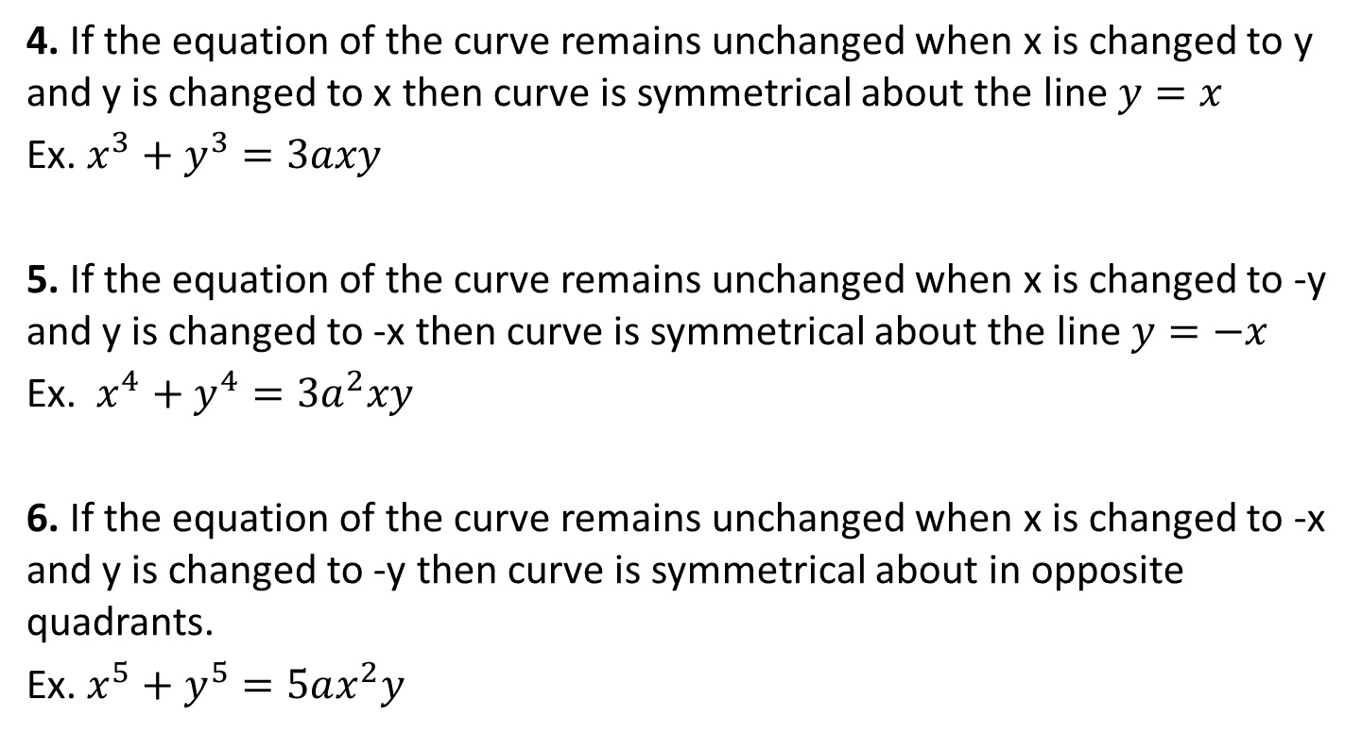
Curve Tracing,(CO2..)
4. If the equation of the curve remains unchanged when x is changed to y and y is changed to x then curve is symmetrical about the line$y=x$
Ex. $x^{3}+y^{3}=3axy$
5. If the equation of the curve remains unchanged when x is changed to -y and y is changed to -x then curve is symmetrical about the line$y=−x$
Ex. $x^{4}+y^{4}=3a^{2}xy$
6. If the equation of the curve remains unchanged when x is changed to -x and y is changed to -y then curve is symmetrical about in opposite quadrants.
Ex. $x^{5}+y^{5}=5ax^{2}y$

Slide 38
Curve Tracing,(CO2..)
II.Origin-
If the constant term is missing from the equation of the curve then it passes through the origin.
IF CURVE PASSES THROUGH THE ORIGIN THEN
Find the tangents at origin for this we equate to zero the lowest degree terms appear in equation.
1. If the two tangents are real and distinct then origin is NODE.
2. If the two tangents are real and coincide then origin is CUSP.
3. If the two tangents are conjugate (or isolated) then origin are
IMAGINARY.

Slide 39
Curve Tracing,(CO2..)
NOTE-
1. A cusp is called a single cusp or a double cusp according as the two branches of the curve lie entirely on one side or both sides of the common normal.
2. A cusp single or double is said to be of first kind or second kind according as the two branches of the curve, lie on opposite or same side of the common tangent.
III. Asymptotes-
Find all the asymptotes of the curve. The curve will not go beyond its asymptotes.

Slide 40
Curve Tracing,(CO2..)
1.Asymptotes parallel to x-axis-
We equate to zero the coefficients of the highest power of x . If the coefficients of the highest power of x is constant then there is no asymptotes parallel to x-axis.
2.Asymptotes parallel to y-axis-
We equate to zero the coefficients of the highest power of y. If the coefficients of the highest power of y is constant then there is no asymptotes parallel to y-axis.
3.Oblique asymptotes- write the equation of the form

Slide 41
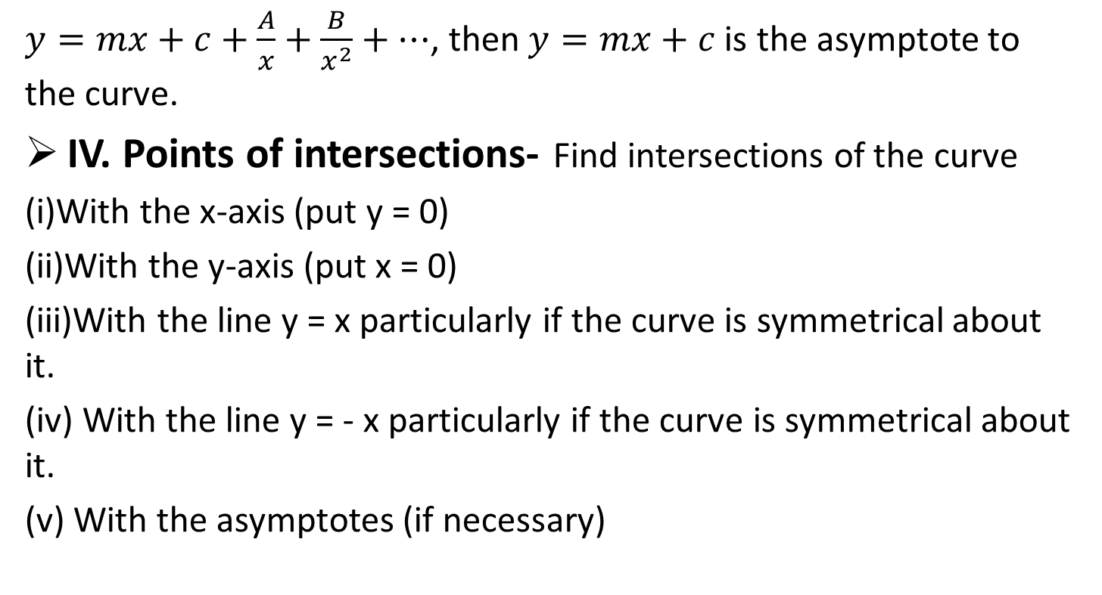
Curve Tracing,(CO2..)
$y=mx+c+\frac{A}{x}+\frac{B}{x^{2}}+…$, then $y=mx+c$ is the asymptote to the curve.
IV. Points of intersections- Find intersections of the curve
(i)With the x-axis (put y = 0)
(ii)With the y-axis (put x = 0)
(iii)With the line y = x particularly if the curve is symmetrical aboutit.
(iv) With the line y = - x particularly if the curve is symmetrical about it.
(v) With the asymptotes (if necessary)

Slide 42
Curve Tracing,(CO2..)
Note-
If curve cuts the axis at the point (a,0) then find the equation of the tangent at the point (a,0).
For this we put x = X + a and y = Y + 0 in given equation of curve and equate to zero the lowest degree terms.
V. Region-Find regions in the four quadrants to which the curve is limited.
VI. Result- Considering all these points ,found the rough shape of curve .

Slide 43
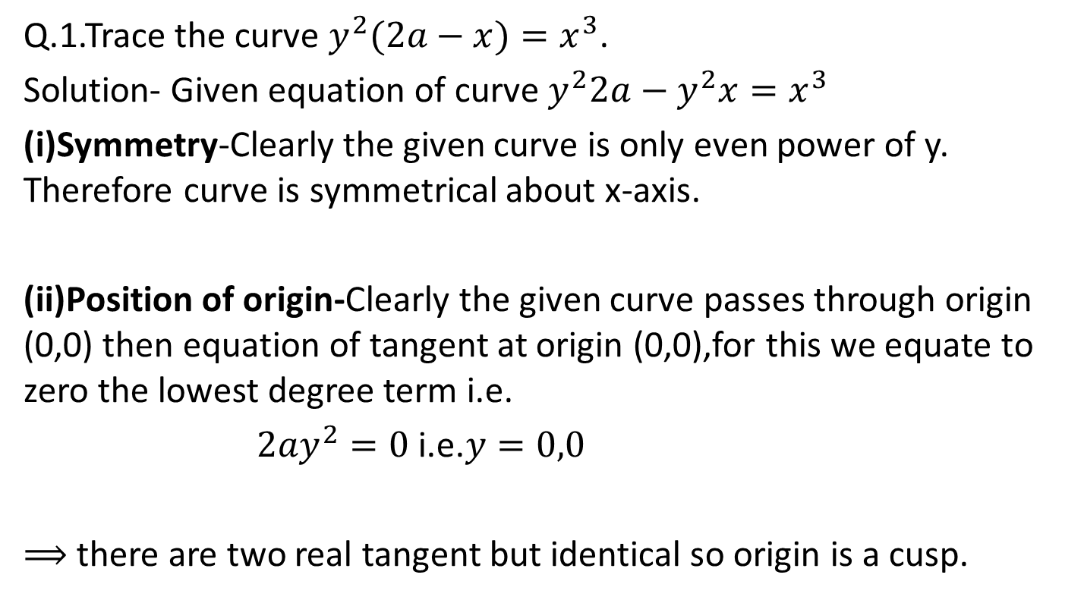
Curve Tracing,(CO2..)
Q.1.Trace the curve $y^{2}(2a−x)=x^{3}$.
Solution- Given equation of curve$y^{2}2a−y^{2}x=x^{3}$
(i)Symmetry-Clearly the given curve is only even power of y. Therefore curve is symmetrical about x-axis.
(ii)Position of origin-Clearly the given curve passes through origin (0,0) then equation of tangent at origin (0,0),for this we equate to zero the lowest degree term i.e.
$2ay^{2}=0$ i.e.$y=0,0$
$⟹$there are two real tangent but identical so origin is a cusp.

Slide 44
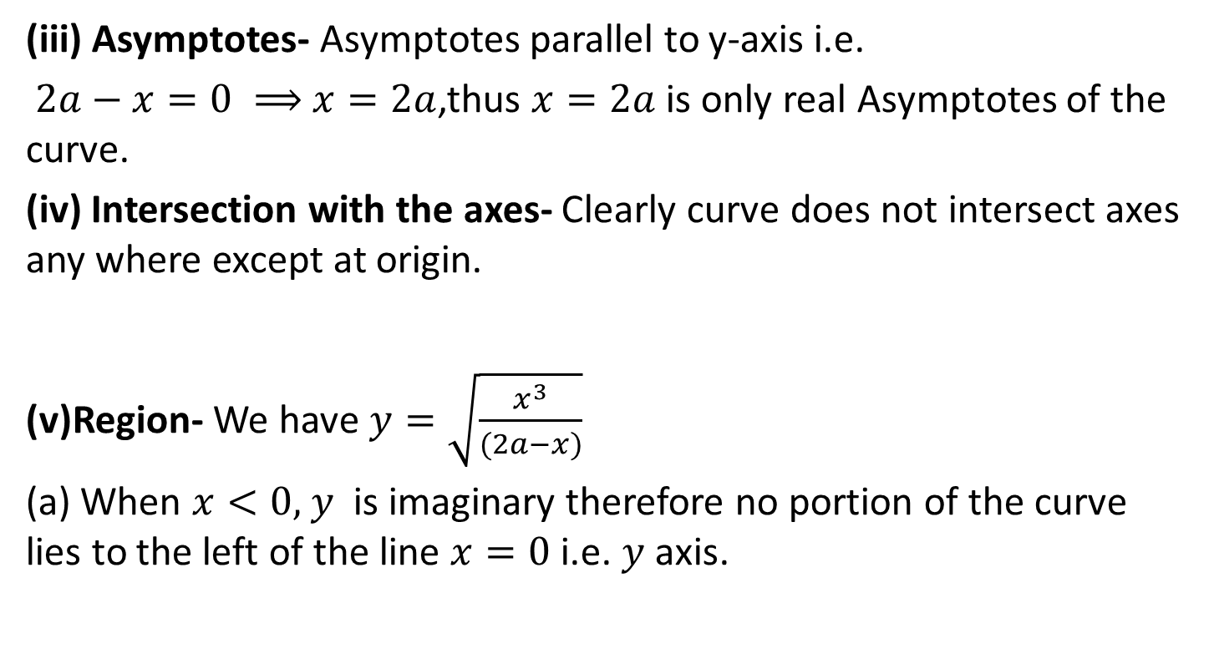
Curve Tracing,(CO2..)
(iii) Asymptotes- Asymptotes parallel to y-axis i.e.
$2a−x=0 ⟹x=2a$,thus$x=2a$ is only real Asymptotes of the curve.
(iv) Intersection with the axes- Clearly curve does not intersect axes any where except at origin.
(v)Region- We have$y=\sqrt{\frac{x^{3}}{(2a−x)}}$
(a) When $x<0,y$ is imaginary therefore no portion of the curve lies to the left of the line $x=0$ i.e. $y$ axis.

Slide 45
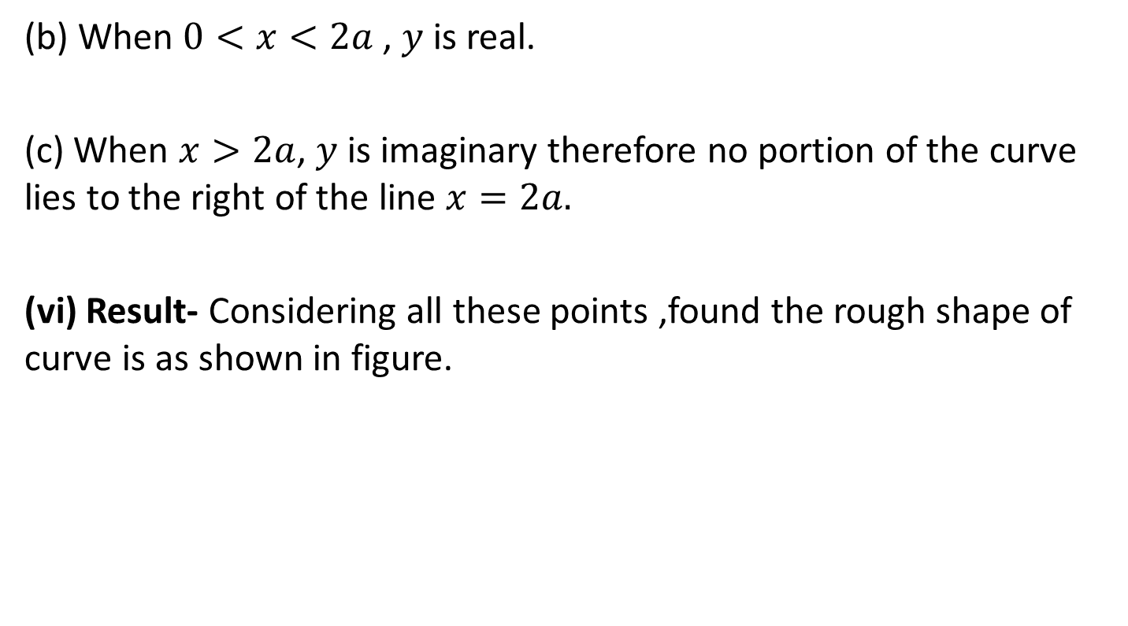
Curve Tracing,(CO2..)
(b) When $0<x<2a$ ,$y$ is real.
(c) When $x>2a$,$y$ is imaginary therefore no portion of the curve lies to the right of the line $x=2a.$
(vi) Result- Considering all these points ,found the rough shape of curve is as shown in figure.

Slide 46
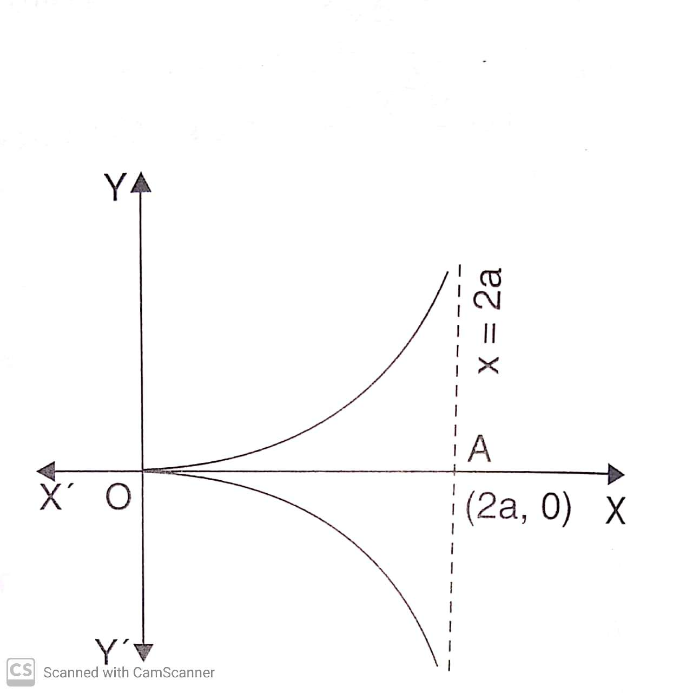
Curve Tracing,(CO2..)

Slide 47
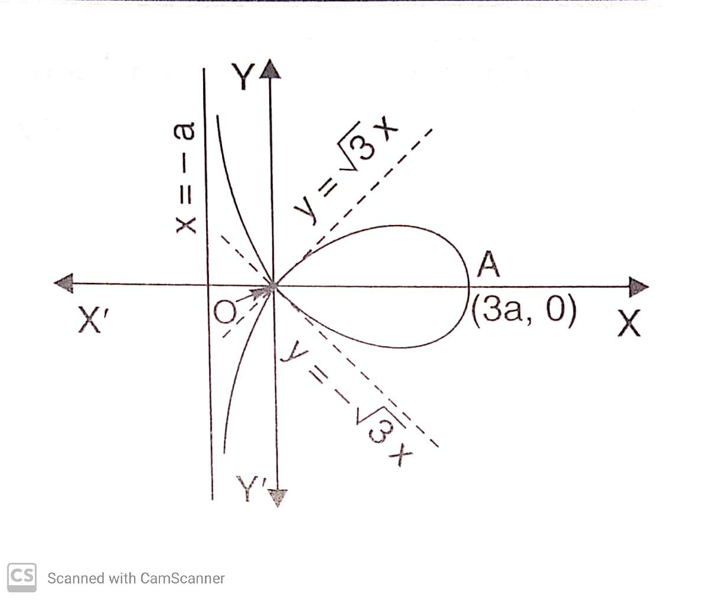
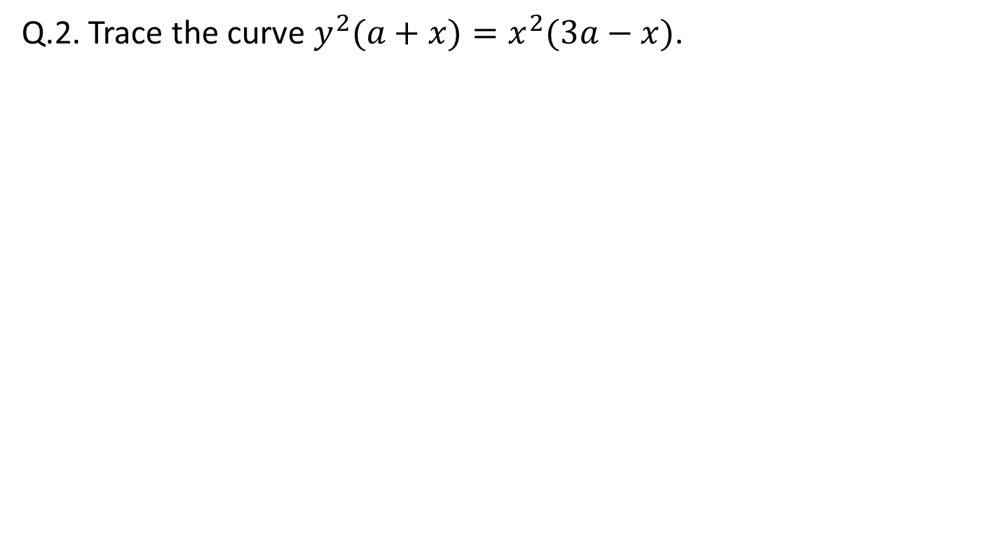
Curve Tracing,(CO2..)
Q.2. Trace the curve $y^{2}(a+x)=x^{2}(3a−x)$.

Slide 48
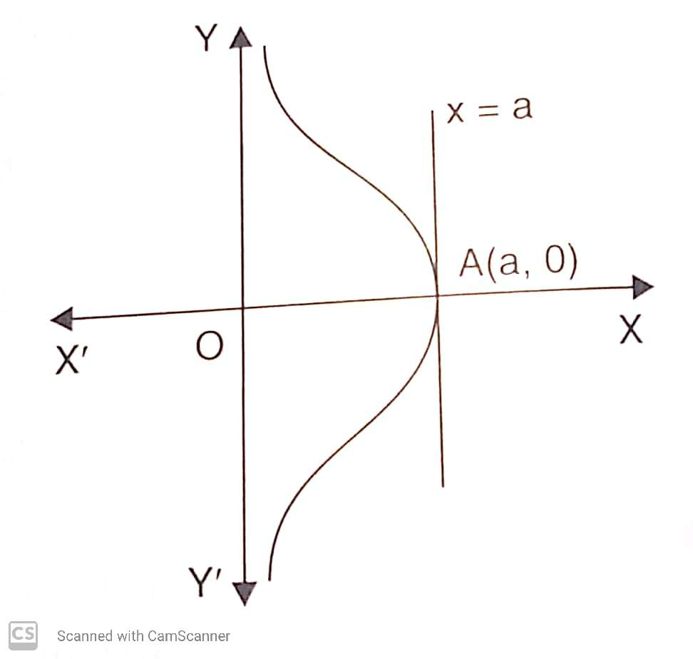
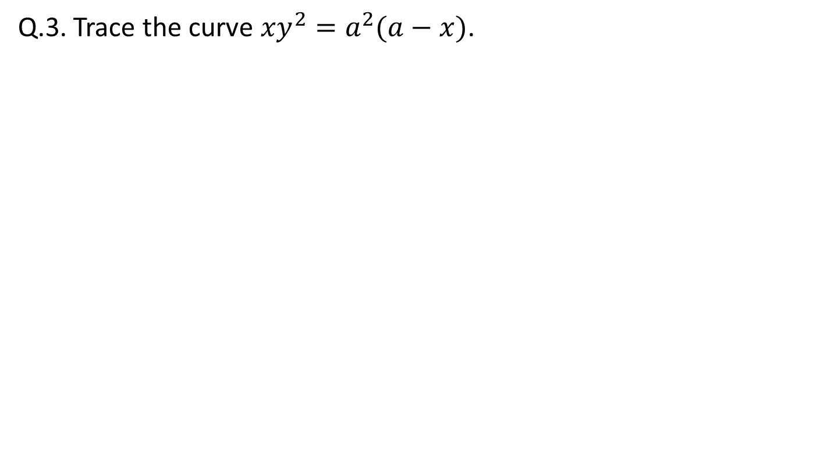
Curve Tracing,(CO2..)
Q.3. Trace the curve ${xy}^{2}=a^{2}(a−x)$.

Slide 49
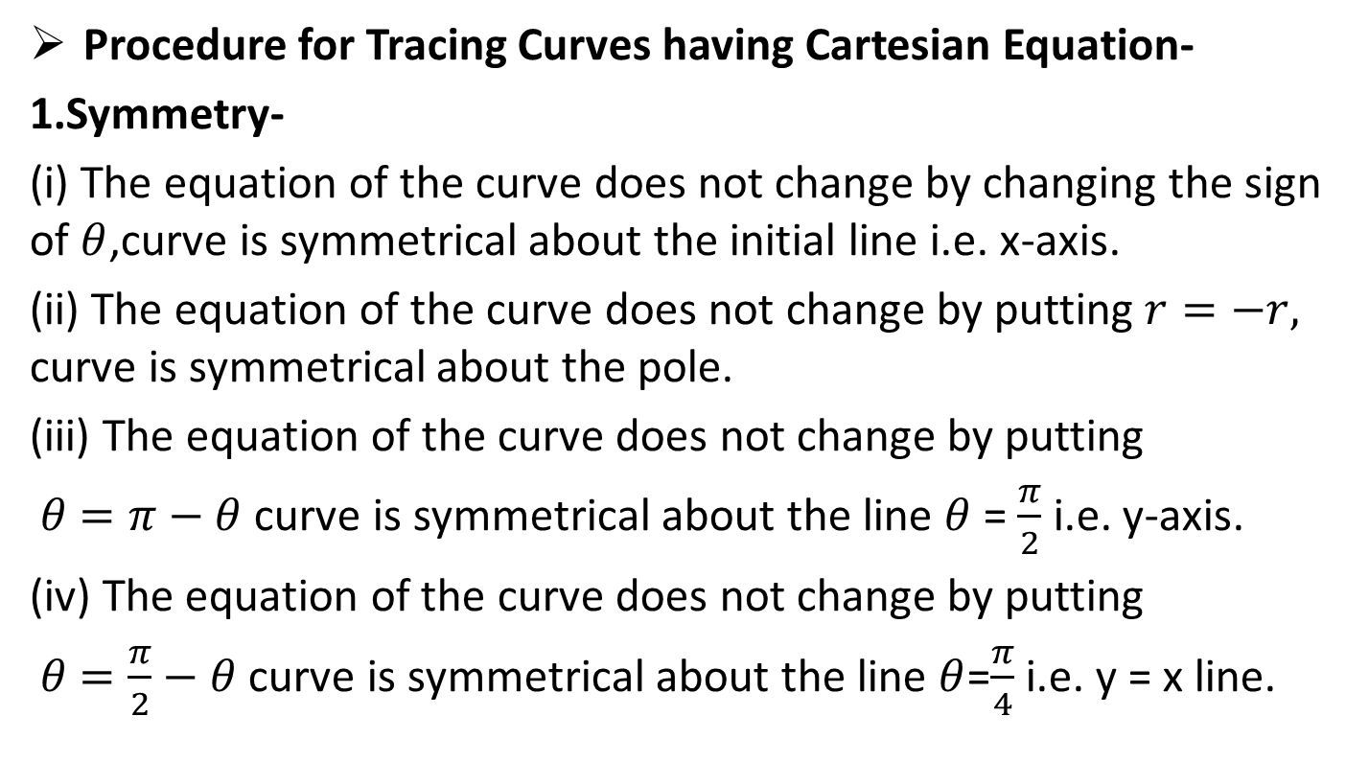
Curve Tracing,(CO2..)
Procedure for Tracing Curves having Cartesian Equation-
1.Symmetry-
(i) The equation of the curve does not change by changing the sign of $θ$,curve is symmetrical about the initial line i.e. x-axis.
(ii) The equation of the curve does not change by putting$r=−r,$ curve is symmetrical about the pole.
(iii) The equation of the curve does not change by putting
$θ=π−θ$curve is symmetrical about the line$θ$= $\frac{π}{2}$ i.e. y-axis.
(iv) The equation of the curve does not change by putting
$θ=\frac{π}{2}−θ$curve is symmetrical about the line$θ$=$\frac{π}{4}$ i.e. y = x line.

Slide 50
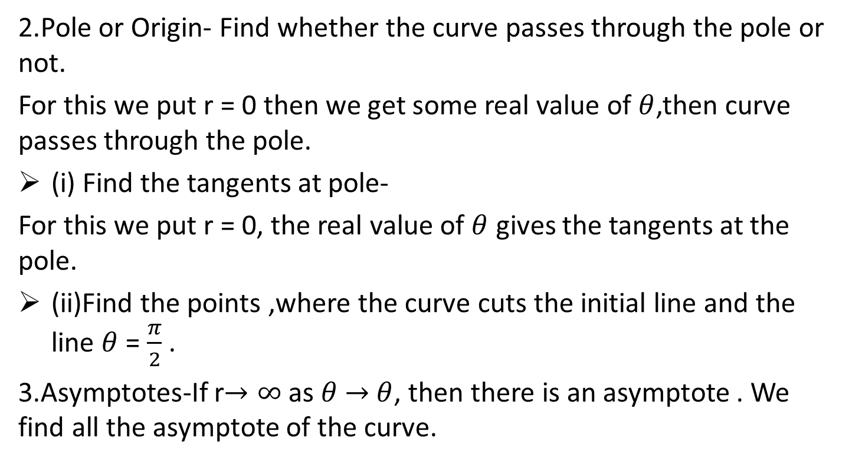
Curve Tracing(CO2..)
2.Pole or Origin- Find whether the curve passes through the pole or not.
For this we put r = 0 then we get some real value of $θ$,then curve passes through the pole.
(i) Find the tangents at pole-
For this we put r = 0, the real value of $θ$ gives the tangents at the pole.
(ii)Find the points ,where the curve cuts the initial line and the line$θ$= $\frac{π}{2}$.
3.Asymptotes-If r$→∞$ as$θ→θ$, then there is an asymptote . We find all the asymptote of the curve.

Slide 51
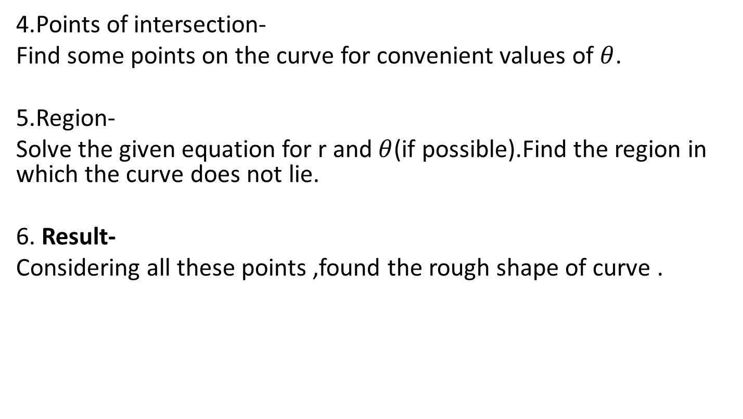
Curve Tracing(CO2..)
4.Points of intersection-
Find some points on the curve for convenient values of$θ$.
5.Region-
Solve the given equation for r and $θ$(if possible).Find the region in which the curve does not lie.
6.Result-
Considering all these points ,found the rough shape of curve .

Slide 52
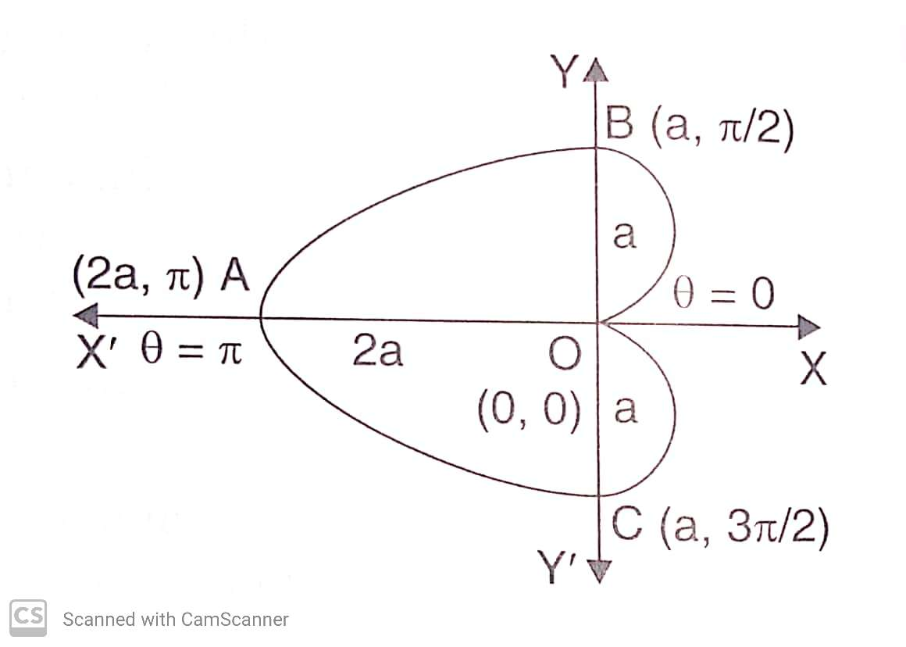
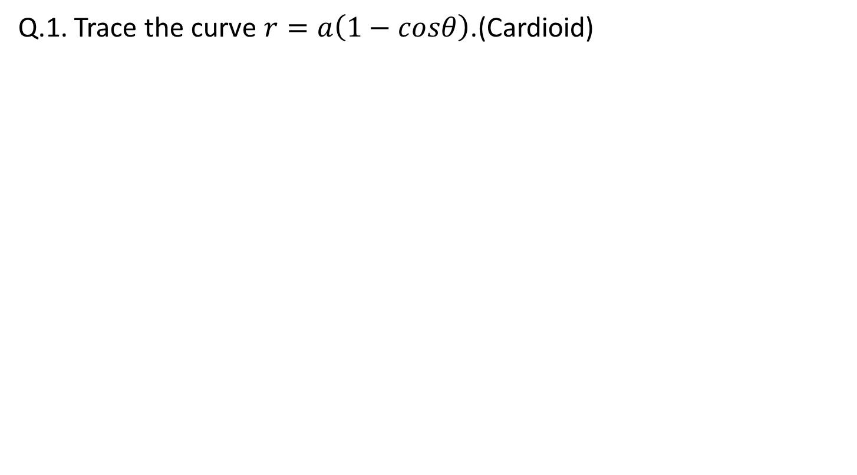
Curve Tracing(CO2..)
Q.1. Trace the curve $r=a\left(1−cosθ\right)$.(Cardioid)

Slide 53
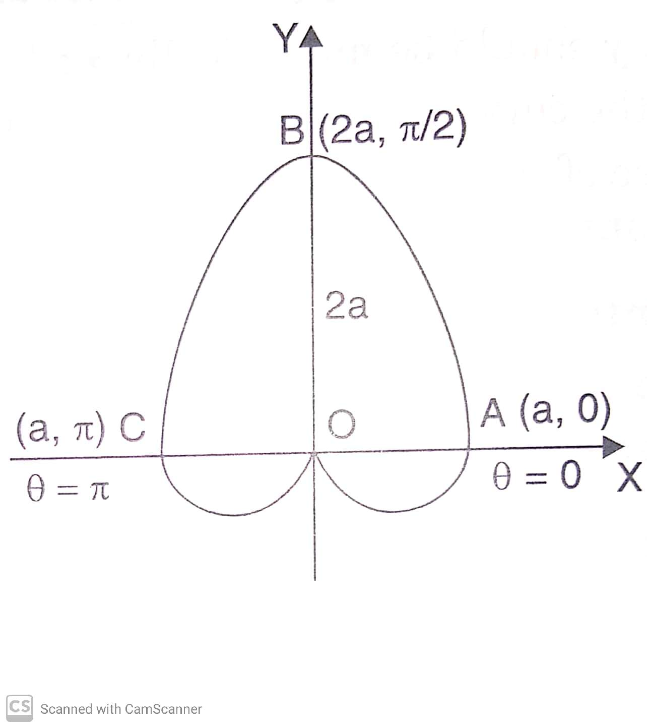
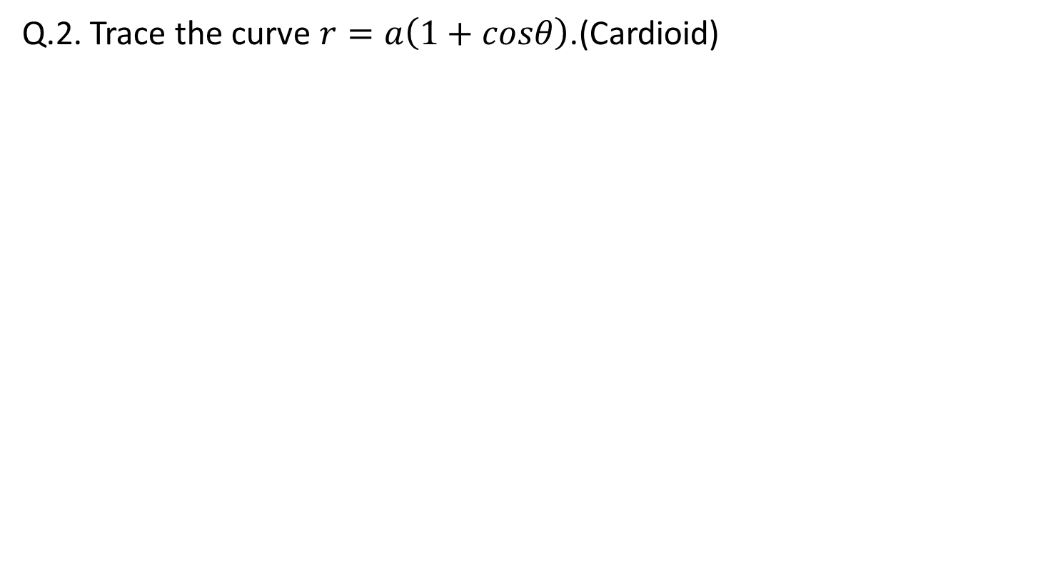
Curve Tracing(CO2..)
Q.2. Trace the curve $r=a\left(1+cosθ\right)$.(Cardioid)

Slide 54
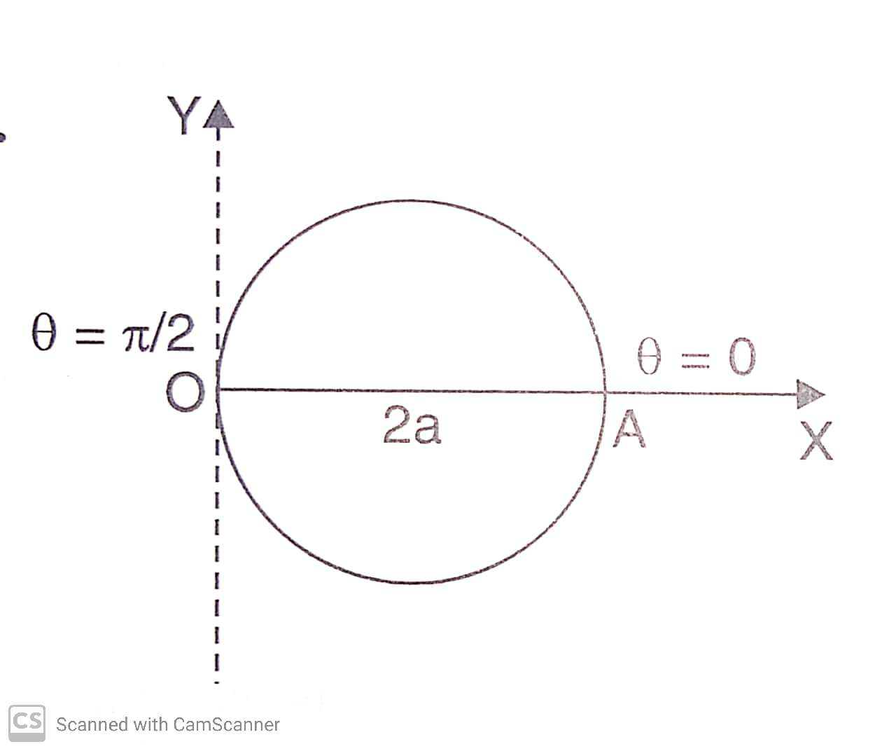
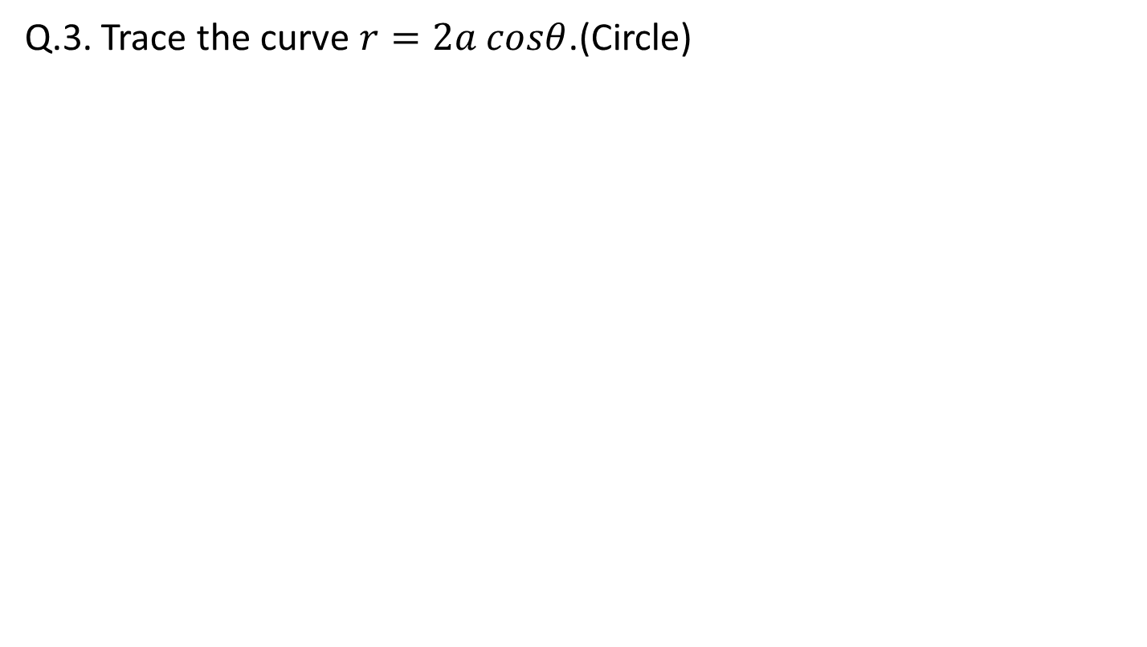
Curve Tracing(CO2..)
Q.3. Trace the curve $r=2a cosθ$.(Circle)

Slide 55
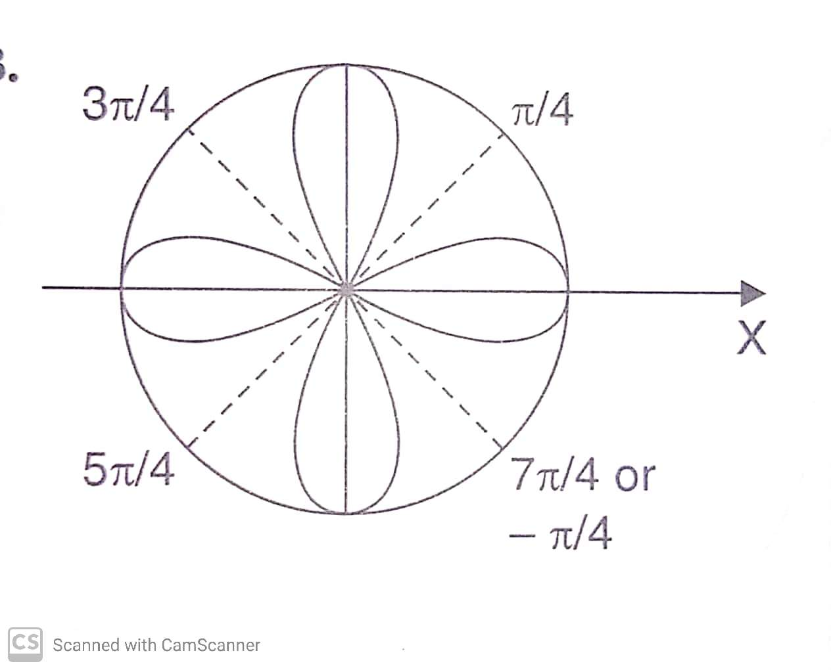
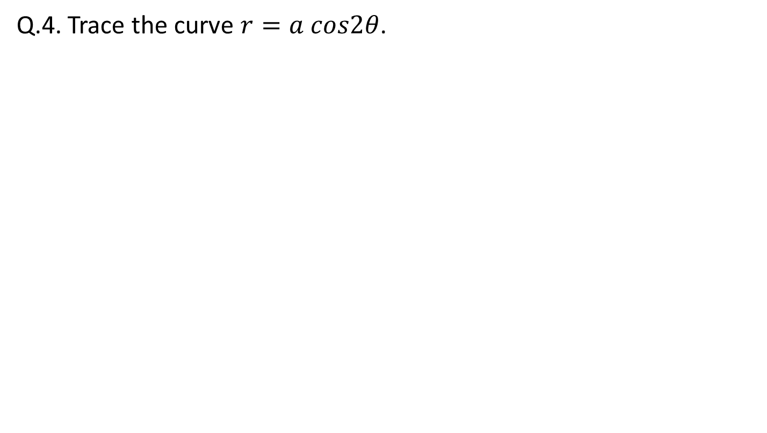
Curve Tracing(CO2..)
Q.4. Trace the curve $r=a cos2θ$.

Slide 56
Curve Tracing(CO2..)
Q.1. If even power of y then curve is symmetrical…..
Q.2. If even power of x then curve is symmetrical…..
Q.3. If highest power of x are constant then the Asymptote….

Slide 57
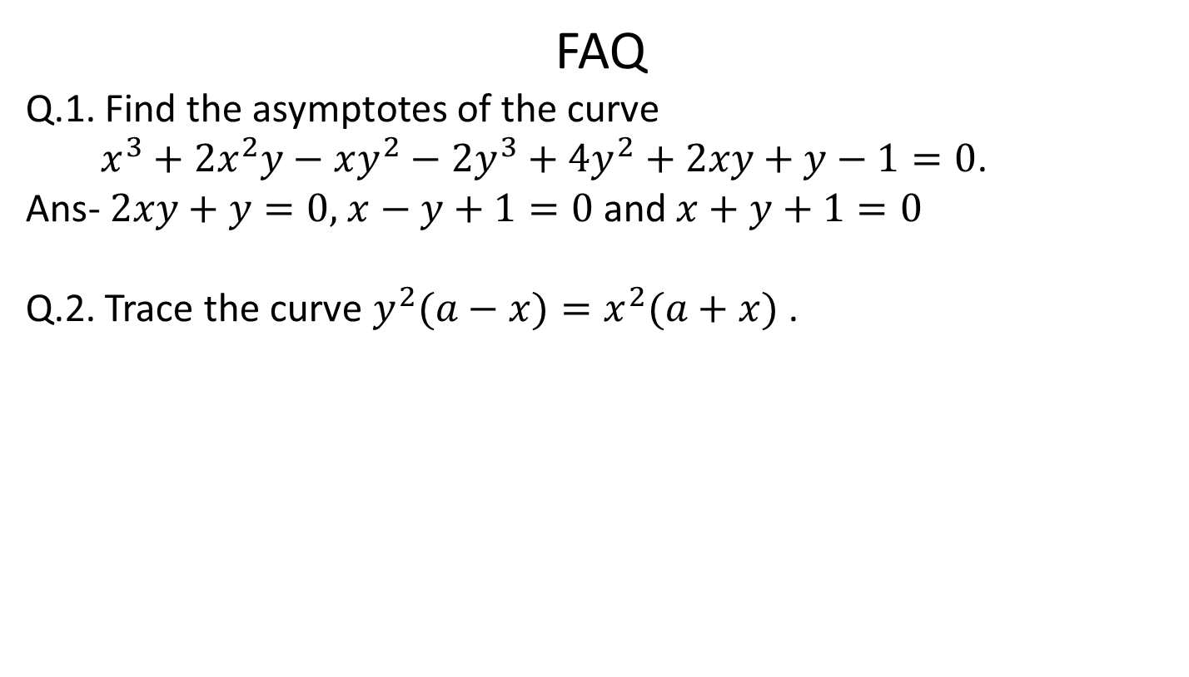
Curve Tracing(CO2..)
FAQ
Q.1. Find the asymptotes of the curve
$x^{3}+2x^{2}y−xy^{2}−2y^{3}+4y^{2}+2xy+y−1=0$.
Ans- $2xy+y=0,x−y+1=0$ and$x+y+1=0$
Q.2. Trace the curve $y^{2}(a−x)=x^{2}(a+x)$ .

Slide 58
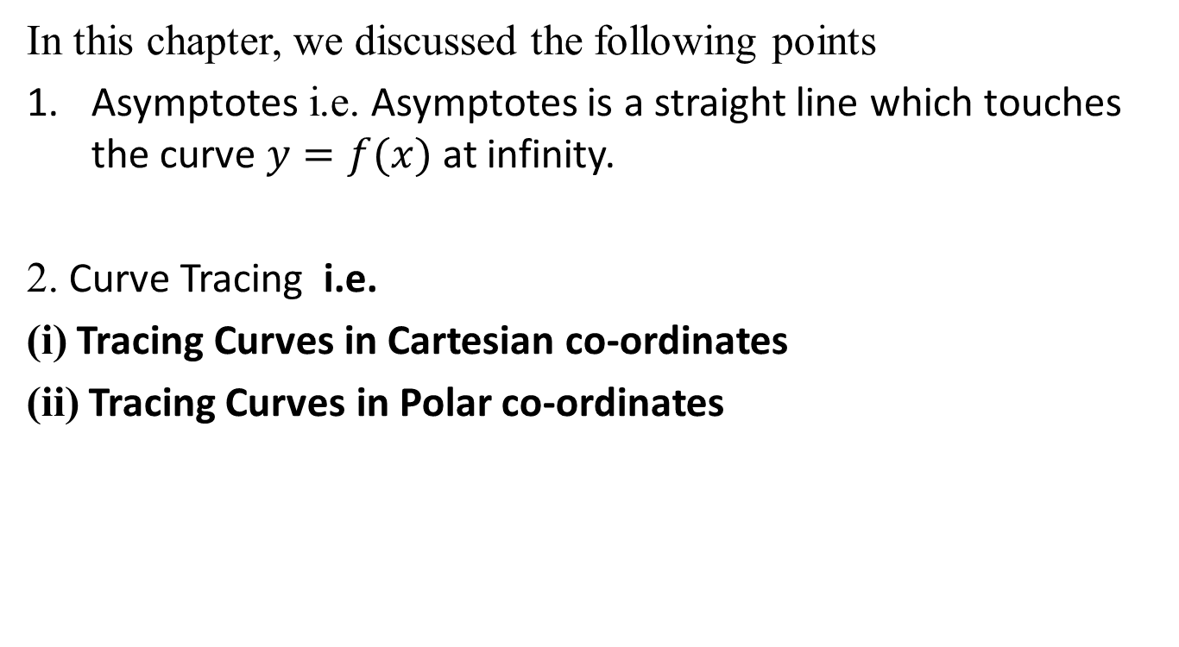
Recap
In this chapter, we discussed the following points
Asymptotes i.e. Asymptotes is a straight line which touches the curve $y=f(x)$ at infinity.
2. Curve Tracing i.e.
(i) Tracing Curves in Cartesian co-ordinates
(ii) Tracing Curves in Polar co-ordinates

Slide 59
Topic Objective
Partial derivatives (CO 2)
Student will be able to understand partial derivatives and solve problems related to partial derivatives.
Partial derivatives are used in solving the problem related to vector calculus and differential geometry.

Slide 60
Partial derivatives (CO2)
Function of two variables:
If three variables x, y, z are so related that value of z depends upon the values of x and y, then z is called function of x and y and is denoted as
The set of points (x, y) in the x-y plane for which f(x, y) is defined is called the domain of f(x, y) and denoted as D.
The domain may be entire x-y plane or a part of the x-y plane
The collection of corresponding values of z is called the range of f(x, y)

Slide 61
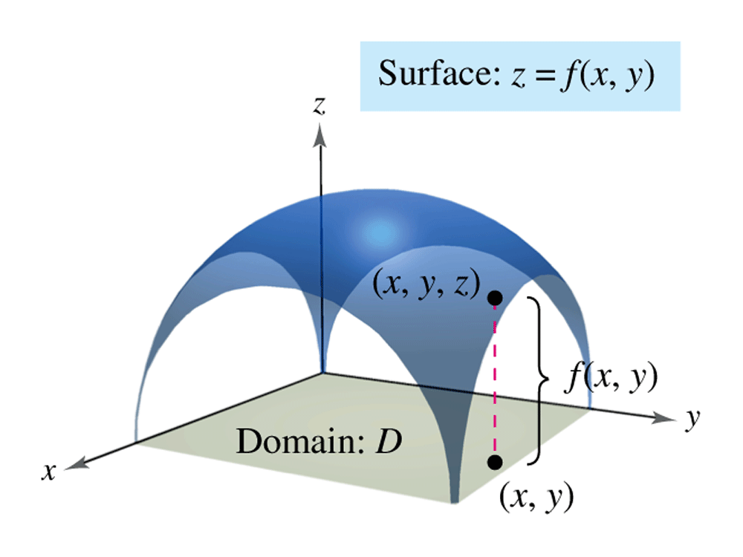
Geometrical Interpretation (CO2)

Slide 62
First Order Partial Derivatives (CO2)
Let z = f(x, y) be a function of two independent variables x and y.
The partial derivative of z with respect to x treating y as constant is denoted as

Slide 63
First Order Partial Derivatives (CO2)
Let z = f(x, y) be a function of two independent variables x and y.
The partial derivative of z with respect to y treating x as constant is denoted as

Slide 64
Higher Derivatives (CO2)
If z = f(x, y), then for second order partial derivatives we use the following notation:

Slide 65
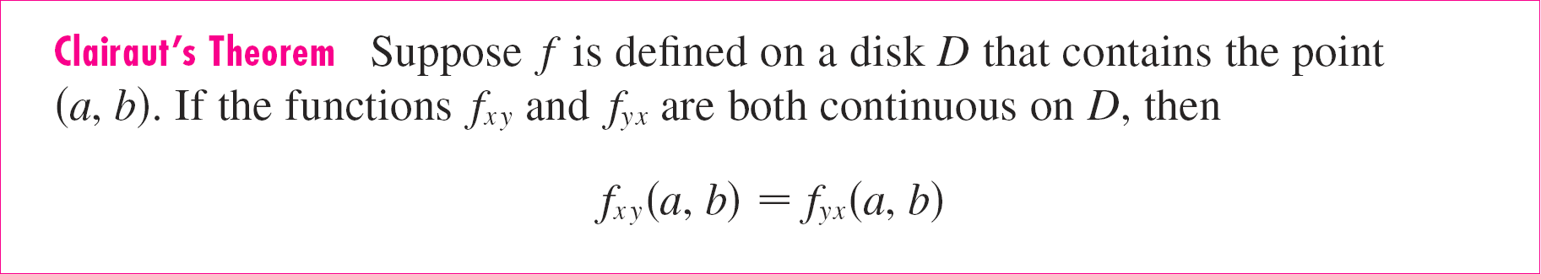
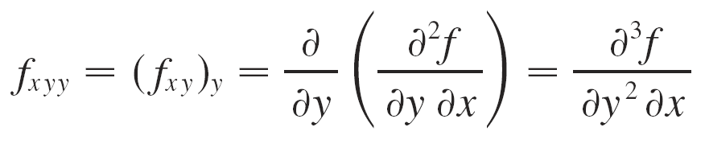
Mixed Partial Derivatives (CO2)
Partial derivatives of order 3 or higher can also be defined.
For instance,and using Clairaut’s Theorem we can show that
f_{xyy} = f_{yxy} = f_{yyx} if these functions are continuous.

Slide 66
Example 1

Slide 67
Example 2
Question:
Solution: Holding y constant and differentiating with respect to x, we get
Holding x constant and differentiating with respect to y, we get

Slide 68
Example 3
Question:
Solution: Using the Chain Rule for functions of one variable, we have

Slide 69
Example 4
Question:
Solution:

Slide 70
Example 5
Question:
Find the second partial derivatives of
Solution:
Therefore

Slide 71
Example 6
Question:
Solution:

Slide 72
Example 6 Contd…

Slide 73
FAQ

Slide 74
Quiz

Slide 75
Faculty Video Links, Youtube & NPTEL Video Links and Online Courses Details
Partial derivatives:
NPTEL Series: Lecture 05 - Partial Derivatives-https://www.youtube.com/watch?v=6tQTRlbkbc8

Slide 76
Recap
Definition of partial derivative
Notations for partial derivatives
Finding partial derivatives
Interpretations of partial derivatives
Function of more than two variables
Higher derivatives

Slide 77
Topic Objective
Total Derivative (CO 2)
Student will be able to understand concepts of composite function and evaluate the total derivative.

Slide 78
Composite Function (CO2)
If u = f(x, y) is a differentiable function of x and y, where x = g(t) and y = h(t) are both differentiable functions of t. Then,
u is said to be a composite function of t.
If z = f(x, y) is a differentiable function of x and y, where x = g(u,v) and y = h(u,v) are both differentiable functions of u,v . Then,
z is said to be a composite function of u,v.

Slide 79
Differentiation of Composite Function (CO2)
Chain Rule - Case 1
Suppose that z = f(x, y) is a differentiable function of x and y, where
x = g(t) and y = h(t) are both differentiable functions
of t. Then, z is a differentiable function of t and
Z
t
is called the total differential coefficient of z with regard to t.

Slide 80
Differentiation of Composite Function (CO2)
Chain Rule - Case 2
Suppose z = f(x, y) is a differentiable function of x and y, where x = g(s, t) and y = h(s, t) are differentiable functions of s and t.

Slide 81
Deduction (CO2)
If both x and y are functions of x then,
We obtain:

Slide 82
Example 1
Question: If z = x²y + 3xy⁴, where x = sin 2t and y = cos t, find dz/dt .
Solution: The Chain Rule gives

Slide 83
Example 3
Question: Find dy/dx, if x³ + y³ = 6xy.
Solution:
Let F(x, y) = x³ + y³ – 6xy = 0

Slide 84
Example 4
Question:
Solution:

Slide 85
Example 4 Contd…
On adding eq. (1) , (2) and (3)

Slide 86
FAQ

Slide 87
Faculty Video Links, Youtube & NPTEL Video Links and Online Courses Details
Total derivatives
Lecture 09 – Chain rule 1
https://www.youtube.com/watch?v=McT-UsFx1Es
Lecture 10 – Chain rule 2
https://www.youtube.com/watch?v=_1TNtFqiFQo
Change of variables
Lecture 10 – Chain rule 2
https://www.youtube.com/watch?v=X6kp2o3mGtA

Slide 88
Recap
Composite function
Total Derivatives
Chain rule case 1
Chain rule case 2

Slide 89
Topic Objective
Euler’s Theorem for Homogeneous Fn. (CO 2)
Student will be able to understand the concepts homogeneous function and apply the Euler’s theorem for homogeneous function.
It is useful to study the mathematical theorem that establishes a relationship between a homogeneous function and its partial derivatives.

Slide 90
Homogeneous Function (CO2)

Slide 91
Euler’s Theorem on Homogeneous Function (CO2)

Slide 92
Deductions From Euler’s Theorem (CO2)

Slide 93
Example 1
Question:
.
If
, prove that
Solution: Let
and
= 0 + 0 (since are homogenous functions of degree zero)

Slide 94
Example 2
Question:
.
If
, Then find
Solution:
Here u is a homogenous functions of degree 3

Slide 95
Example 3
Question:
Solution:

Slide 96
Example 3 Contd…

Slide 97
Example 3 Contd…

Slide 98
FAQ

Slide 99
Quiz

Slide 100
Faculty Video Links, Youtube & NPTEL Video Links and Online Courses Details
Euler’s theorem
Lecture 12: Euler’s theorem for homogeneous function
https://www.youtube.com/watch?v=btLWNJdHzSQ

Slide 101
Recap
Homogeneous function
Euler’s Theorem
Deduction

Slide 102
Faculty Video Links, Youtube & NPTEL Video Links and Online Courses Details
Successive Differentiation(nth order derivatives)-
https://www.youtube.com/watch?v=PkuPGKSacu0&list=PL2FUpm_Ld1Q3H00wVFuwjWOo1gtMXk1eb
Leibnitz’s theorem and its application-
1.https://www.youtube.com/watch?v=QeWrQ9Fz3Wo&t=22s
2. https://www.youtube.com/watch?v=5dFrWCE6bHg
Asymptotes-
https://www.youtube.com/watch?v=WX6O9TiFYsA&t=110s

Slide 103
Faculty Video Links, Youtube & NPTEL Video Links and Online Courses Details
Curves Tracing (Cartesian co-ordinates) –https://www.youtube.com/watch?v=GII1ssdR2cg&list=PLhSp9OSVmeyK2yt8hdoo3Qze3O0Y67qaY
Curves Tracing (Polar co-ordinates) - https://www.youtube.com/watch?v=0Nv_uSvwh_I&t=3s

Slide 104
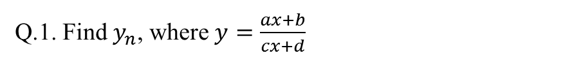
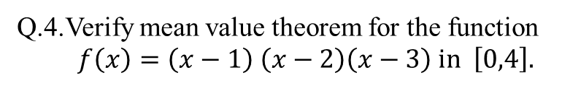
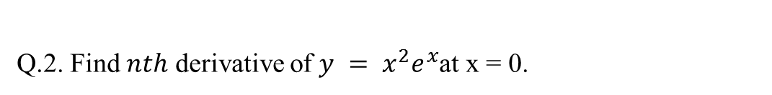
Weekly Assignment,co2
Assignment-2.1
Q.1. Find $y_{n}$, where $y=\frac{ax+b}{cx+d}$
Q.2. Find $nth$ derivative of $y = x^{2}e^{x}$at x = 0.
Q.3. If$y=x^{n}logx,$ prove that $y_{n+1}=\frac{n!}{x}$
Q.4.Verify mean value theorem for the function $f\left(x\right)=\left(x−1\right) \left(x−2\right)\left(x−3\right) in \left[0,4\right].$
Q.5.Verify Rolle’s theorem for the function $f\left(x\right)=e^{x} sinx in \left[0,π\right].$
Q.6. Show that the function $f$ defined by $f\left(x\right)={\left|x\right|}^{3} , x∈R$ is differentiable at $x=0$ and $f^{′}\left(0\right)=0$

Slide 105
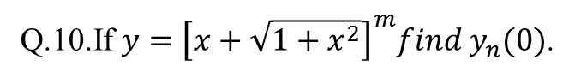
Weekly Assignment,co2
Assignment-2.1
Q.7.If $y=sin\left(a\sin^{−1}x\right)$ show that $\left(1−x^{2}\right)y_{n+2}−\left(2n+1\right)xy_{n+1}−\left(n^{2}−a^{2}\right)y_{n}=0.$
Q.8.If $y= {(sin}^{−1}x)^{2}$then find$y_{n }(0)$.
Q.9.If $y=e^{m\cos^{−1}x}$Show that
$\left(1−x^{2}\right)y_{n+2}−\left(2n+1\right)xy_{n+1}−\left(n^{2}+m^{2}\right)y_{n}=0 and calculate y_{n}(0)$.
Q.10.If $y={\left[x+\sqrt{1+x^{2}}\right]}^{m}find y_{n}(0)$.
Q.11.If $x=sin\sqrt{y} find y_{n}(0)$.

Slide 106
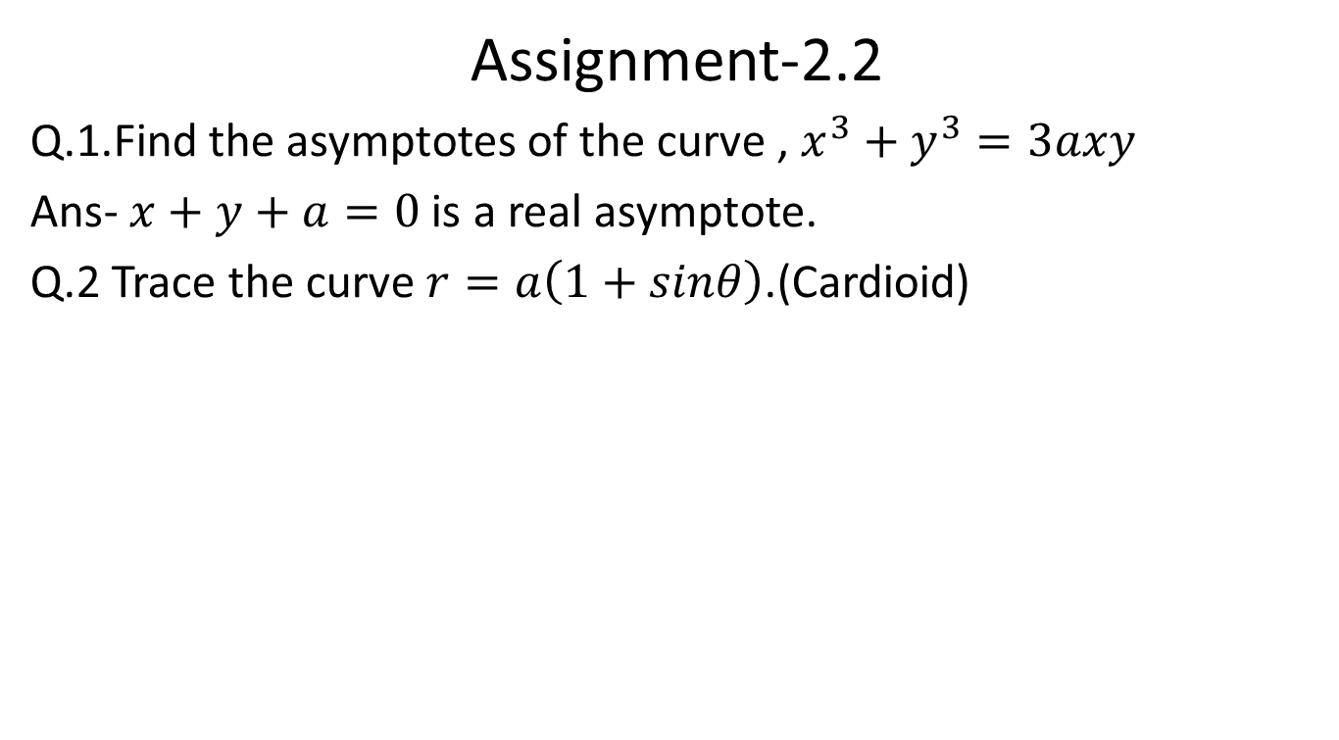
Weekly Assignment,co2
Assignment-2.2
Q.1.Find the asymptotes of the curve , $x^{3}+y^{3}=3axy$
Ans- $x+y+a=0$ is a real asymptote.
Q.2Trace the curve $r=a\left(1+sinθ\right)$.(Cardioid)
Q.3.Trace the curve $y^{2}\left(x−a\right)= x^{2}(x+a)$
Q.4.Trace the curve : $y^{2}\left(a+x\right)=x^{2}\left(3a−x\right)$.

Slide 107
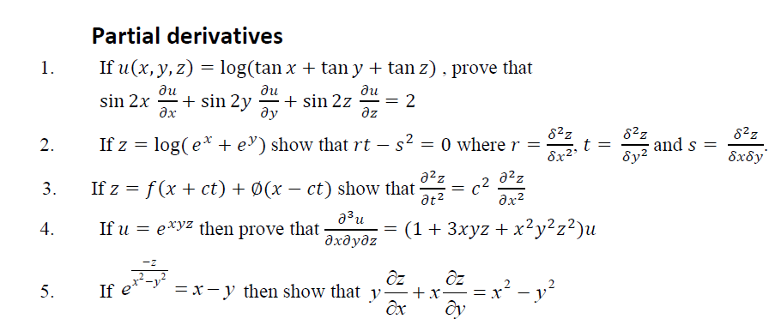
Weekly Assignment (CO2)

Slide 108
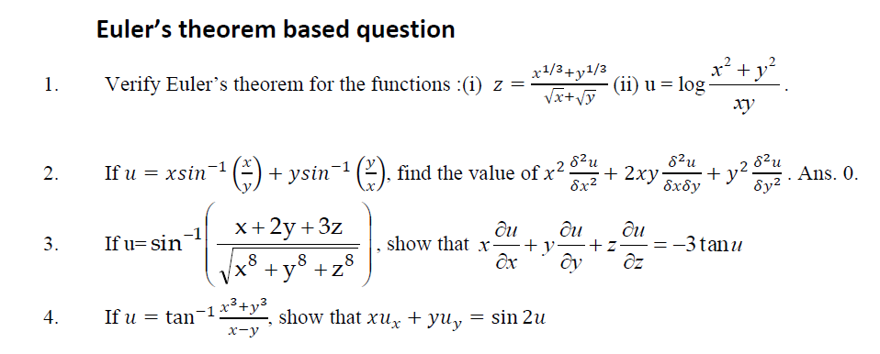
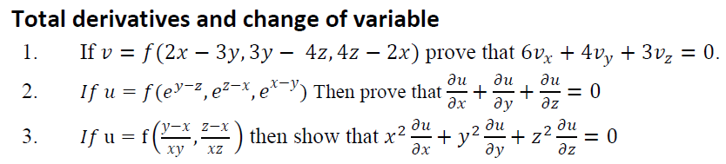
Weekly Assignment (CO2)

Slide 109
MCQ s
Q.1.Curve is symmetrical about x-axis then
(i)Even power of x (ii) Even power of y(iii) Even power of both
(iv) Odd power of x.
Q.2. Curve is symmetrical about y-axis then
(i)Even power of x (ii) Even power of y(iii) Even power of both
(iv) Odd power of x.
Q.3. Curve is symmetrical about both axes then
(i)Even power of x (ii) Even power of y(iii) Even power of both
(iv) Odd power of x.

Slide 110
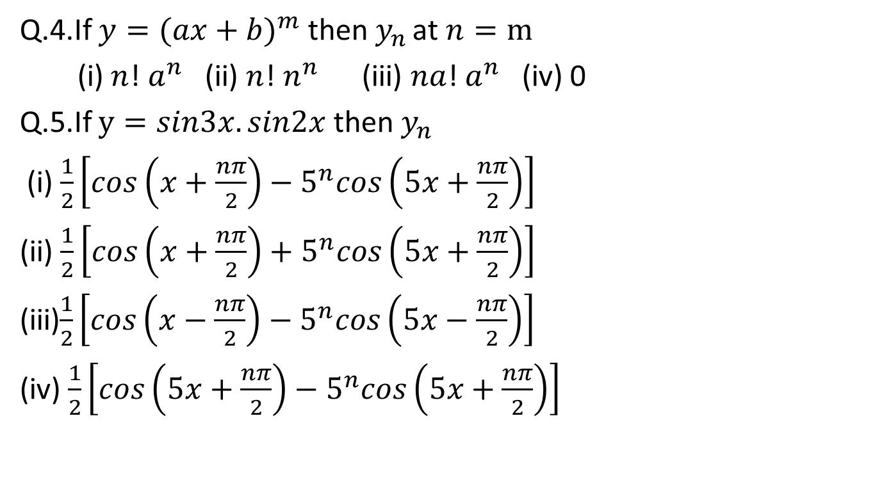
MCQ s
Q.4.If $y={(ax+b)}^{m}$then${ y}_{n }$at$n=m$
(i) $n$! $a^{n}$(ii) $n$! $n^{n}$(iii) $na$! $a^{n}$(iv) 0
Q.5.If$y=sin3x.sin2x$ then${ y}_{n }$
(i) $\frac{1}{2}\left[cos\left(x+\frac{nπ}{2}\right)−5^{n}cos\left(5x+\frac{nπ}{2}\right)\right]$
(ii) $\frac{1}{2}\left[cos\left(x+\frac{nπ}{2}\right)+5^{n}cos\left(5x+\frac{nπ}{2}\right)\right]$
(iii)$\frac{1}{2}\left[cos\left(x−\frac{nπ}{2}\right)−5^{n}cos\left(5x−\frac{nπ}{2}\right)\right]$
(iv) $\frac{1}{2}\left[cos\left(5x+\frac{nπ}{2}\right)−5^{n}cos\left(5x+\frac{nπ}{2}\right)\right]$

Slide 111
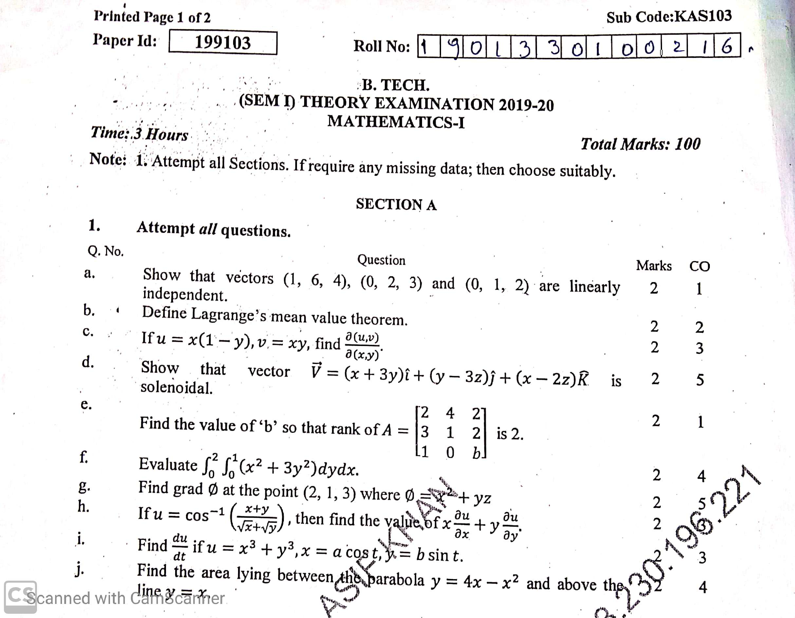
Old Question Papers

Slide 112
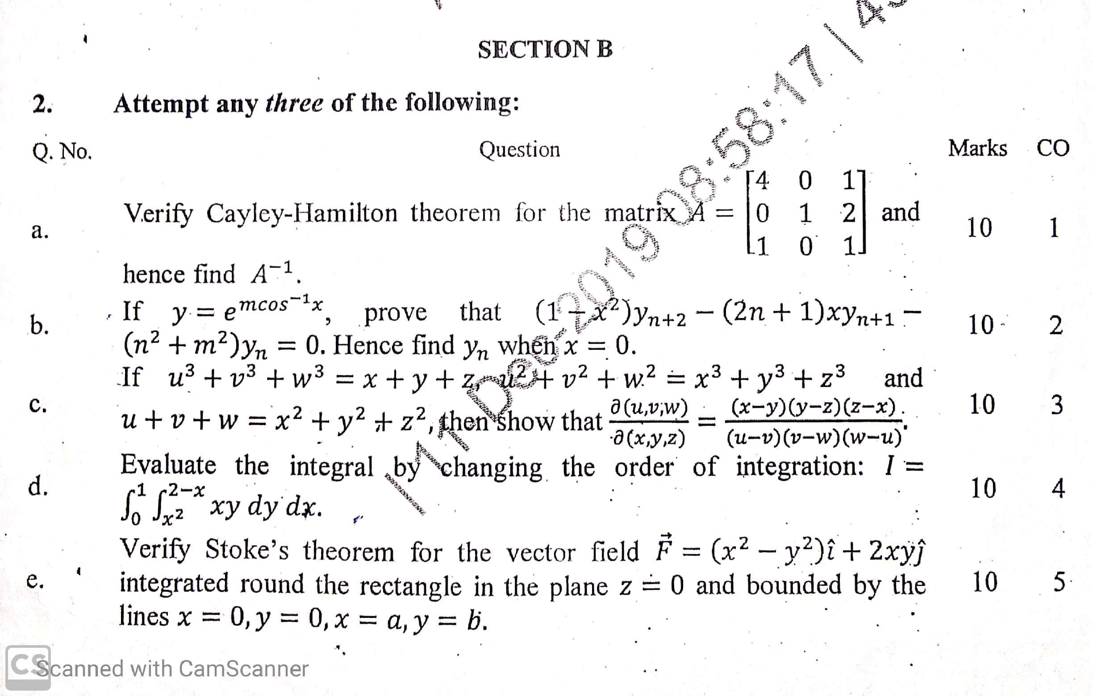
Old Question Papers

Slide 113

Old Question Papers

Slide 114

Old Question Papers

Slide 115

Expected Questions for University Exam
Q.1.Discuss the Continuity of the function$f\left(x\right)=2x+3$ at
$$x=1$$
Q.2.Find the relationship between$a$ and $b$so that the function$f$defined by$f\left(x\right)=\left\{\begin{aligned}ax+1,x≤3 \\ bx+3, x>3\end{aligned}\right.$
Q.3. Verify Cauchy’s mean value theorem for the function
$f\left(x\right)=sinx$ and g$\left(x\right)=cosx$ in$\left[−\frac{π}{2},0\right]$.
Q.4.Evaluate $\lim_{x→0}f\left(x\right),$ where$f\left(x\right)=\left\{\begin{aligned}\frac{x}{\left|x\right|} ,x≠0 \\ 0, x=0\end{aligned}\right.$

Slide 116


Expected Questions for University Exam
Q.5. Find the n^{th} derivative of x²sinx at x = 0. [G.B.T.U.2010]
Ans: (n – n²) sin $\frac{nπ}{2}$
Q.6.If $y=e^{−x}cosx,$ then find the value of y₄ + 4y.[MTU.2011] Ans: 0
Q.7.Find the 8th derivative of x² e^{x}. [G.B.T.U.2013]
Ans: e^{x} (x²+16x+56)
.
Q.8. If $x=sin\left(\frac{logy}{a}\right)$,
prove that $\left(1−x^{2}\right)y_{n+2}−\left(2n+1\right)xy_{n+1}−\left(n^{2}+a^{2}\right)y_{n}=0$.
Q.9If $y={\left(x^{2}−1\right)}^{n}$,
prove that $\left(x^{2}−1\right)y_{n+2}+2xy_{n+1}−n\left(n+1\right)y_{n}=0.$ Hence
if $P_{n}=\frac{d^{n}}{dx^{n}}{\left(x^{2}−1\right)}^{n}, show that \frac{d}{dx}\left\{(1−x^{n})\frac{dP_{n}}{dx}\right\}+n\left(n+1\right)P_{n}=0.$

Slide 117


Expected Questions for University Exam
Q.10.If $y^{1/m}+y^{−1/m}=2x$,
Prove that ${(x}^{2}−1)y_{n+2}+\left(2n+1\right)xy_{n+1}+\left(n^{2}−m^{2}\right)y_{n}=0.$
Q.11.$If y=x^{n}\log{x}$ , prove that
$y_{n+1}=\frac{n!}{x}$.
${x^{2}y}_{p+2}+\left(2p−2n+1\right)xy_{p+1}+{\left(p−n\right)}^{2}{ y}_{p}=0.$
.
Q.12.If $y={\left[x+\sqrt{1+x^{2} }\right]}^{m}, find y_{n}\left(0\right).$
Ans:$\left\{\begin{aligned}When n is even, {\{m}^{2}(m^{2}{−2}^{2}){(m}^{2}{−4}^{2})………[m^{2}{−(n−2)]}^{2}\} \\ When n is odd, \left\{m(m^{2}{−1}^{2}){(m}^{2}{−3}^{2})………[m^{2}{−(n−2)]}^{2}\right\}\end{aligned}\right\}$

Slide 118

Expected Questions for University Exam
Q.13.Find the asymptotes of the curve , $x^{3}+y^{3}=3axy$
Ans- $x+y+a=0$ is a real asymptote.
Q.14. Trace the curve $r=a\left(1+sinθ\right)$.(Cardioid)
Q.15.Trace the curve $y^{2}(2a−x)=x^{3}$.

Slide 119
Summary
In this unit(Differential Calculus-I), we discussed the following points :
Course Objective
COs and POs of subject
Mapping of COs and Pos
Prerequisite and Recap
Introduction(Calculus)
Introduction of Limit , continuity, differentiability

Slide 120
Summary
Rolle’s Theorem
Lagrange’ Mean value Theorem
Cauchy mean value Theorem
Successive Differentiation(nth order derivatives)
Leibnitz’s theorem and its application
Asymptotes.
Curve tracing: Cartesian and Polar Co-ordinates
Partial Differentiation
Euler’s Theorem

Slide 121
References
Text Books
Ray Wylie C and Louis C Barret, Advanced Engineering Mathematics, Tata Mc-Graw-Hill; Sixth Edition.
B. V. Ramana, Higher Engineering Mathematics, Tata Mc Graw-Hill Publishing Company Ltd., 2008.
B. S. Grewal, Higher Engineering Mathematics, Khanna Publisher, 2005.
R K. Jain & S R K. Iyenger , Advance Engineering Mathematics, Narosa Publishing House 2002.

Slide 122
References
Reference Books
E. Kreyszig, Advance Engineering Mathematics, John Wiley & Sons, 2005.
Peter V. O’Neil, Advance Engineering Mathematics, Thomson (Cengage) Learning, 2007.
Maurice D. Weir, Joel Hass, Frank R. Giordano, Thomas, Calculus, Eleventh Edition, Pearson.
D. Poole, Linear Algebra : A Modern Introduction, 2nd Edition, Brooks/Cole, 2005.
Veerarajan T., Engineering Mathematics for first year, Tata McGraw-Hill, New Delhi, 2008.

Slide 123
References
Thank You

